Slide 1



DevOps and Continuous Delivery
Reference Architectures
Volume 1
Derek E. Weeks (@weekstweets)
VP and DevOps Advocate
Sonatype

Slide 2









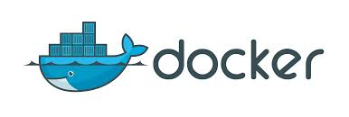


Common Elements of the Software Supply Chain
Notes:
Continuous Delivery and DevOps Reference Architectures include many common tool choices. The most common tool choices we find in these reference architectures are: Eclipse, git, Cloudbees Jenkins / Atlassian Bamboo, Sonatype Nexus, Atlassian JIRA, SonarQube, Puppet, Chef, Rundeck, Maven / Ant / Gradle, Subversion (svn), Junit, LiveRebel, ServiceNow

Slide 3

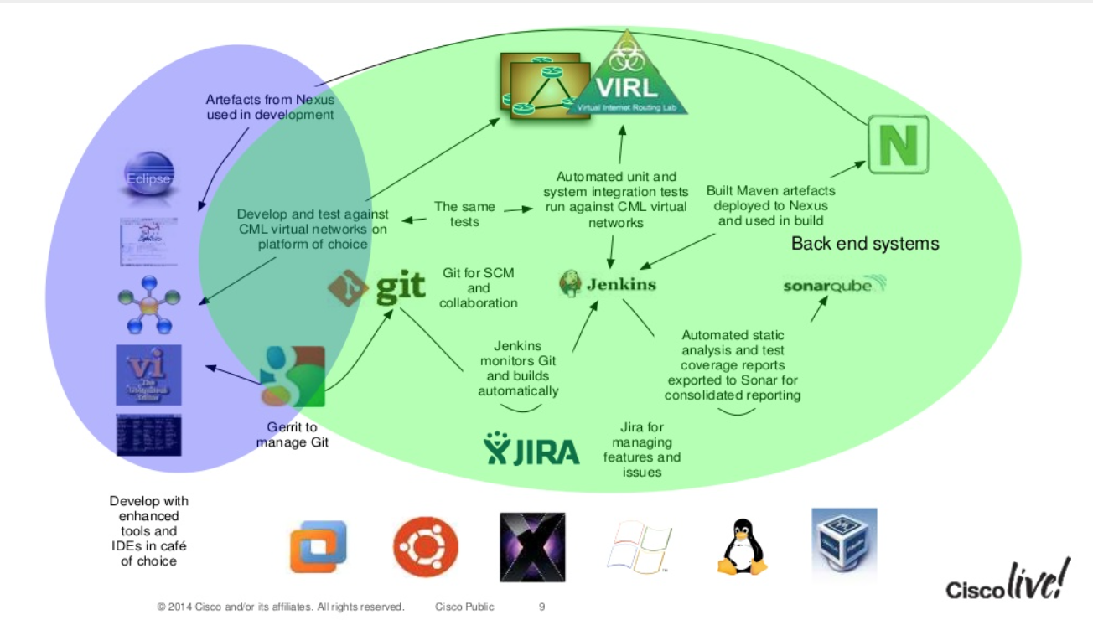
According to Cisco
Link to Presentation: Enabling DevOps in a SDN World
http://www.slideshare.net/CiscoDevNet/enabing-devops-in-an-sdn-world?qid=47004169-099b-4281-ac76-fed8fe1c09bd&v=default&b=&from_search=2
Notes:
Continuous Delivery and DevOps Reference Architectures include many common tool choices. The most common tool choices we find in these reference architectures are: Eclipse, git, Cloudbees Jenkins / Atlassian Bamboo, Sonatype Nexus, Atlassian JIRA, SonarQube, Puppet, Chef, Rundeck, Maven / Ant / Gradle, Subversion (svn), Junit, LiveRebel, ServiceNow

Slide 4

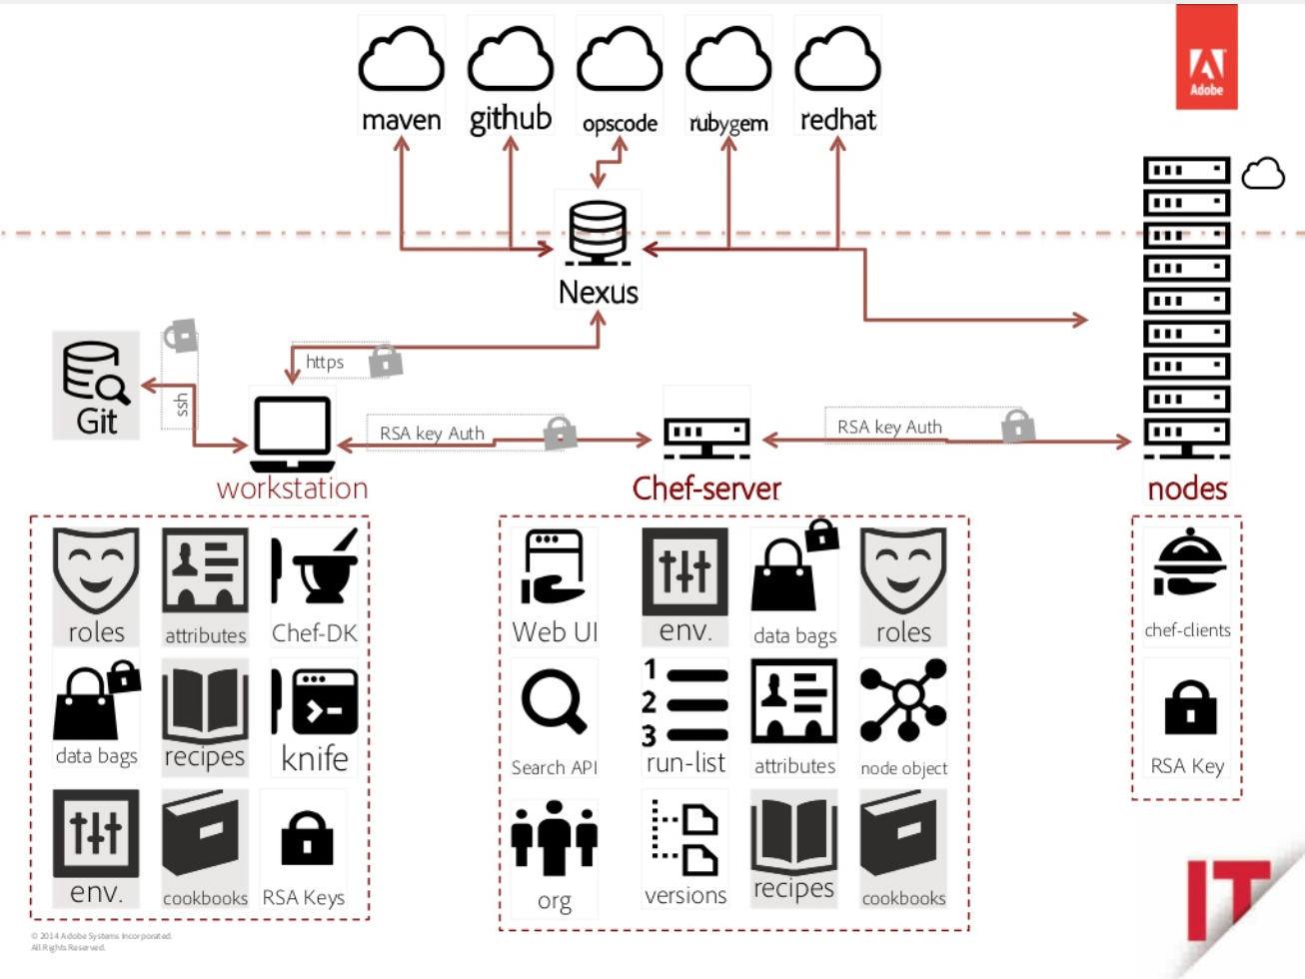
According to Adobe
Link to Presentation: Master Chef class: learn how to quickly cook delightful CQ/AEM infrastructures
http://www.slideshare.net/francoisledroff/master-chef-class-learn-how-to-quickly-cook-delightful-cqaem-infrastructures?qid=9198118a-5b10-4e3e-a7db-9d92e7c2d427&v=default&b=&from_search=7
Notes:
Continuous Delivery and DevOps Reference Architectures include many common tool choices. The most common tool choices we find in these reference architectures are: Eclipse, git, Cloudbees Jenkins / Atlassian Bamboo, Sonatype Nexus, Atlassian JIRA, SonarQube, Puppet, Chef, Rundeck, Maven / Ant / Gradle, Subversion (svn), Junit, LiveRebel, ServiceNow

Slide 5
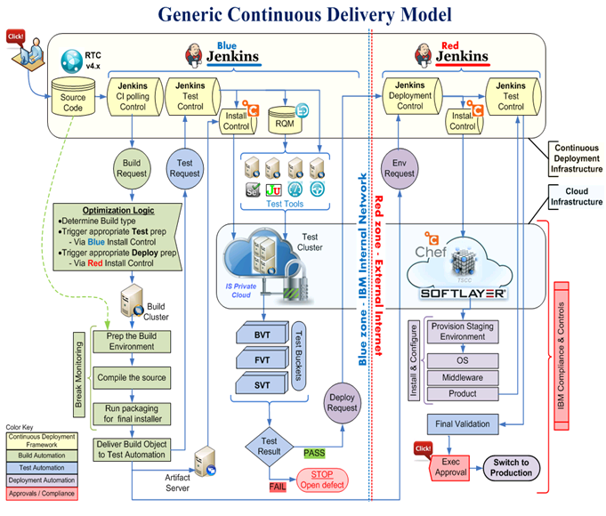
According to IBM
http://www.ibm.com/developerworks/rational/library/deploy-industry-solutions-cloud-platform/
Notes:
Continuous Delivery and DevOps Reference Architectures include many common tool choices. The most common tool choices we find in these reference architectures are: Eclipse, git, Cloudbees Jenkins / Atlassian Bamboo, Sonatype Nexus, Atlassian JIRA, SonarQube, Puppet, Chef, Rundeck, Maven / Ant / Gradle, Subversion (svn), Junit, LiveRebel, ServiceNow

Slide 6

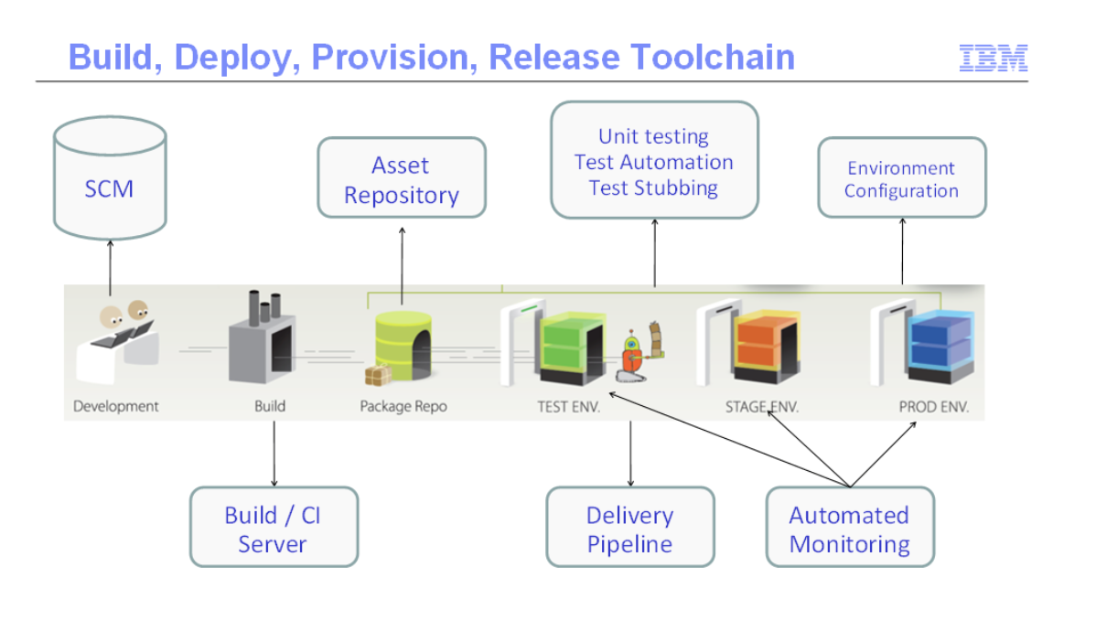
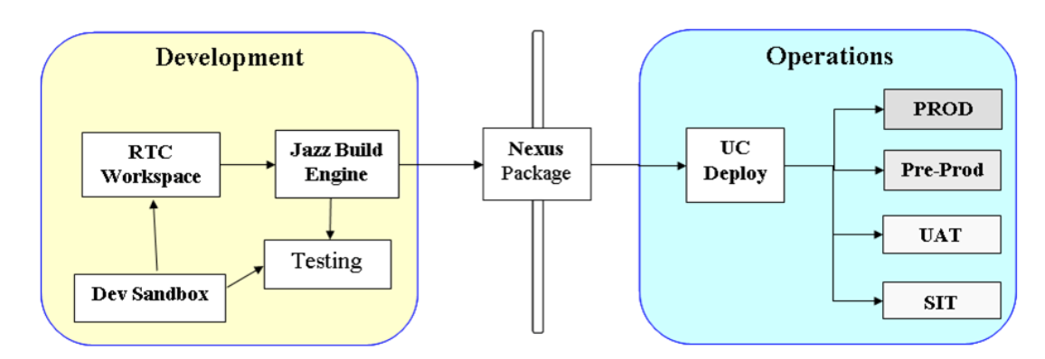
According to IBM
Link to Blog: DevOps Best Practice - Establishing a “Single Source of Truth”
https://www.ibm.com/developerworks/community/blogs/c914709e-8097-4537-92ef-8982fc416138/entry/devops_best_practice_-_establishing_a_%E2%80%9Csingle_source_of_truth%E2%80%9D?lang=en
Notes:
Continuous Delivery and DevOps Reference Architectures include many common tool choices. The most common tool choices we find in these reference architectures are: Eclipse, git, Cloudbees Jenkins / Atlassian Bamboo, Sonatype Nexus, Atlassian JIRA, SonarQube, Puppet, Chef, Rundeck, Maven / Ant / Gradle, Subversion (svn), Junit, LiveRebel, ServiceNow

Slide 7

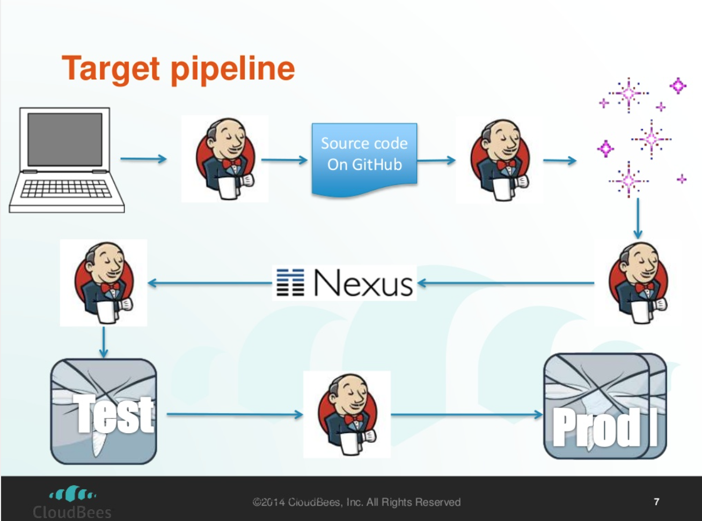
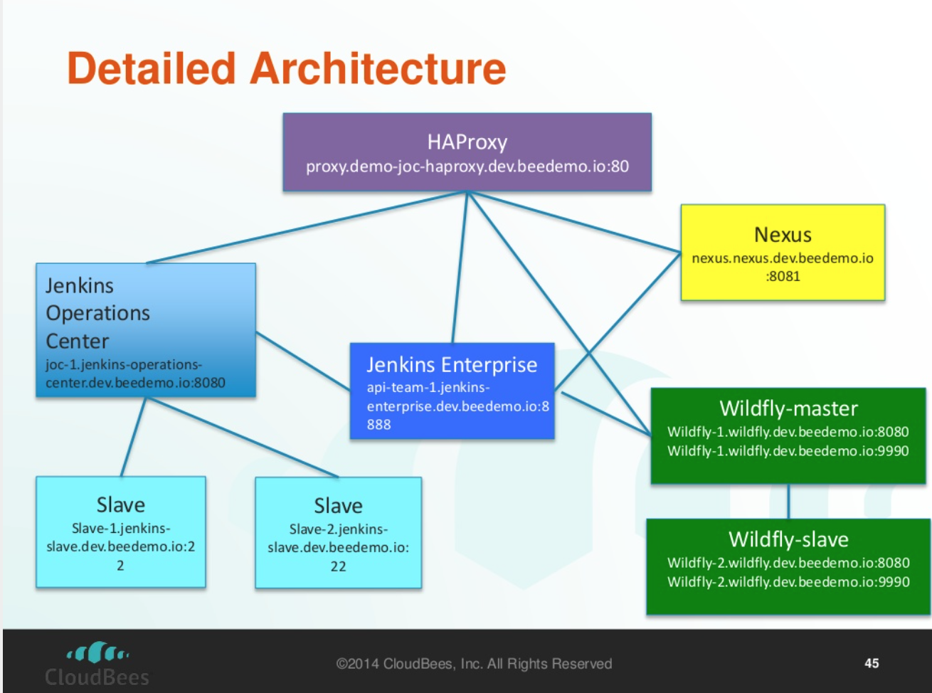
According to Cloudbees
Link to Presentation: Continuous Delivery with Jenkins and Wildfly
http://www.slideshare.net/TracyKennedy2/continuous-delivery-with-jenkins-and-wildfly-2014?qid=11b647a8-1b7e-4f10-af12-1af130d4cd53&v=qf1&b=&from_search=4
Notes:
Continuous Delivery and DevOps Reference Architectures include many common tool choices. The most common tool choices we find in these reference architectures are: Eclipse, git, Cloudbees Jenkins / Atlassian Bamboo, Sonatype Nexus, Atlassian JIRA, SonarQube, Puppet, Chef, Rundeck, Maven / Ant / Gradle, Subversion (svn), Junit, LiveRebel, ServiceNow

Slide 8

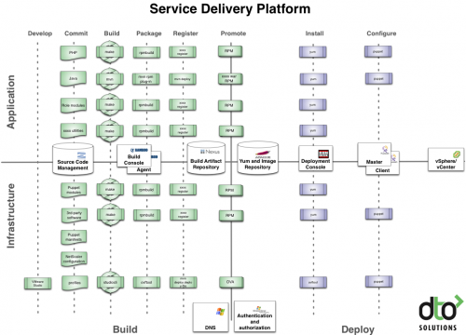
According to Rundeck
Link to Blog: What is DevOps
http://dev2ops.org/2010/02/what-is-devops/
Notes:
Continuous Delivery and DevOps Reference Architectures include many common tool choices. The most common tool choices we find in these reference architectures are: Eclipse, git, Cloudbees Jenkins / Atlassian Bamboo, Sonatype Nexus, Atlassian JIRA, SonarQube, Puppet, Chef, Rundeck, Maven / Ant / Gradle, Subversion (svn), Junit, LiveRebel, ServiceNow

Slide 9
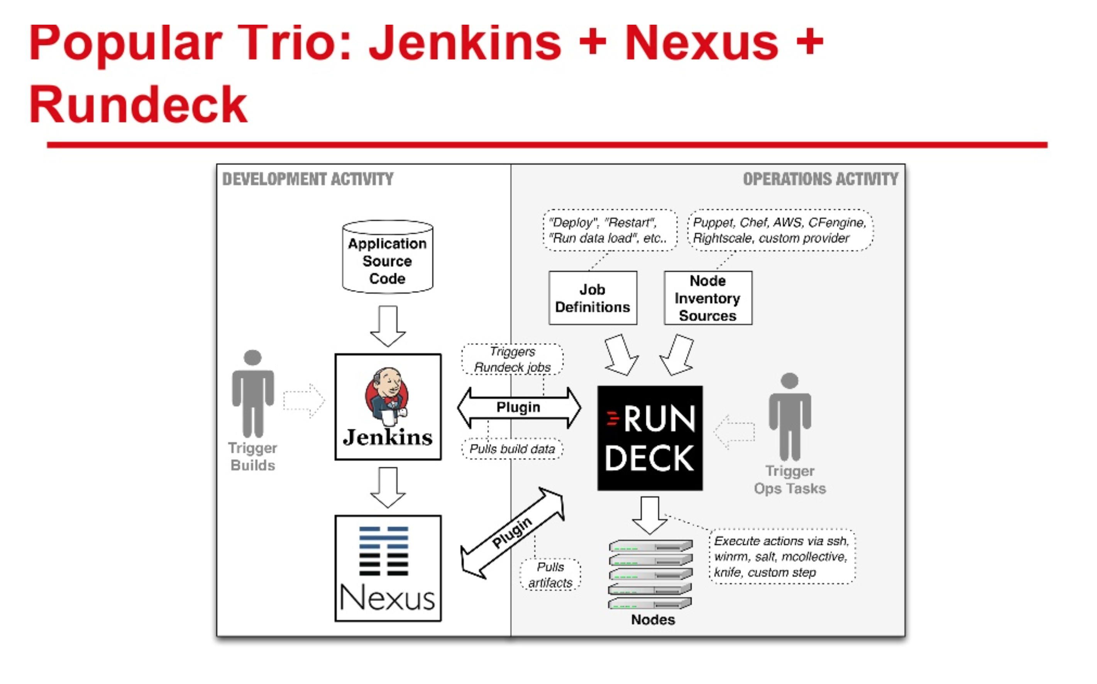
According to Rundeck
Link to Presentation: Rundeck + Nexus (from Nexus Live on June 5, 2014)
http://www.slideshare.net/dev2ops/nexus-live-1?qid=796aed11-d097-4d71-a81b-5b38d53ce90a&v=qf1&b=&from_search=1
Notes:
Continuous Delivery and DevOps Reference Architectures include many common tool choices. The most common tool choices we find in these reference architectures are: Eclipse, git, Cloudbees Jenkins / Atlassian Bamboo, Sonatype Nexus, Atlassian JIRA, SonarQube, Puppet, Chef, Rundeck, Maven / Ant / Gradle, Subversion (svn), Junit, LiveRebel, ServiceNow

Slide 10

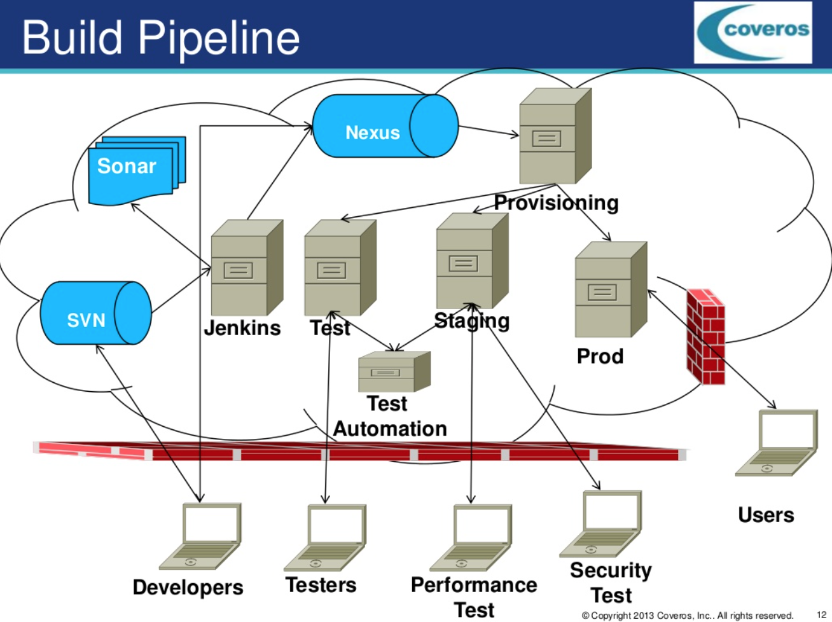
According to Coveros
Link to Presentation: Overcoming problems implementing cloud based dev ops for distributed agile projects
http://www.slideshare.net/tstiehm/overcoming-problems-implementing-cloud-based-dev-ops-for-distributed-agile-projects?qid=75b5e757-3982-4e59-aeef-f80cc61702fc&v=default&b=&from_search=12
Notes:
Continuous Delivery and DevOps Reference Architectures include many common tool choices. The most common tool choices we find in these reference architectures are: Eclipse, git, Cloudbees Jenkins / Atlassian Bamboo, Sonatype Nexus, Atlassian JIRA, SonarQube, Puppet, Chef, Rundeck, Maven / Ant / Gradle, Subversion (svn), Junit, LiveRebel, ServiceNow

Slide 11

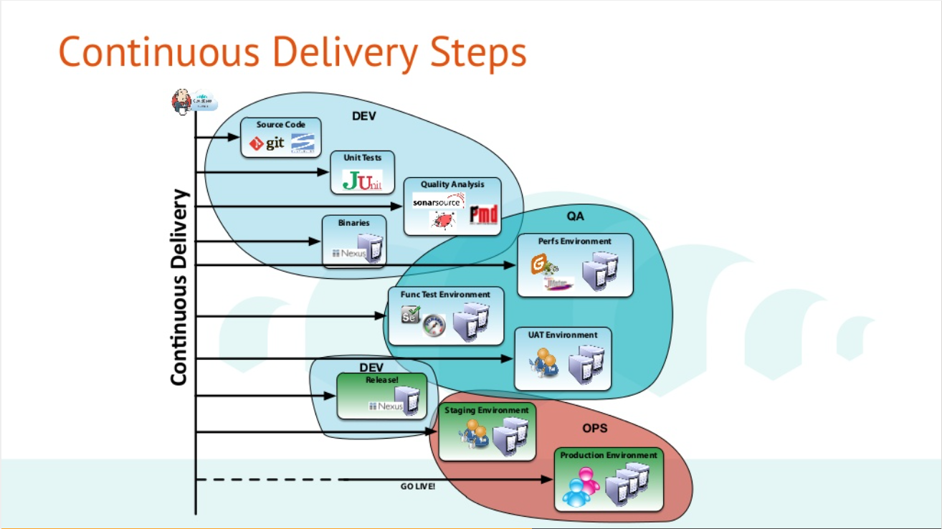
According to Xebia
Link to Presentation: Journée DevOps : De l'intégration continue au déploiement continu avec Jenkins
http://www.slideshare.net/XebiaFrance/journe-devops-de-lintgration-continue-au-dploiement-continu-avec-jenkins?qid=3cfcaad2-05c4-45c6-aed1-cdffcd8dd195&v=default&b=&from_search=24
Notes:
Continuous Delivery and DevOps Reference Architectures include many common tool choices. The most common tool choices we find in these reference architectures are: Eclipse, git, Cloudbees Jenkins / Atlassian Bamboo, Sonatype Nexus, Atlassian JIRA, SonarQube, Puppet, Chef, Rundeck, Maven / Ant / Gradle, Subversion (svn), Junit, LiveRebel, ServiceNow

Slide 12

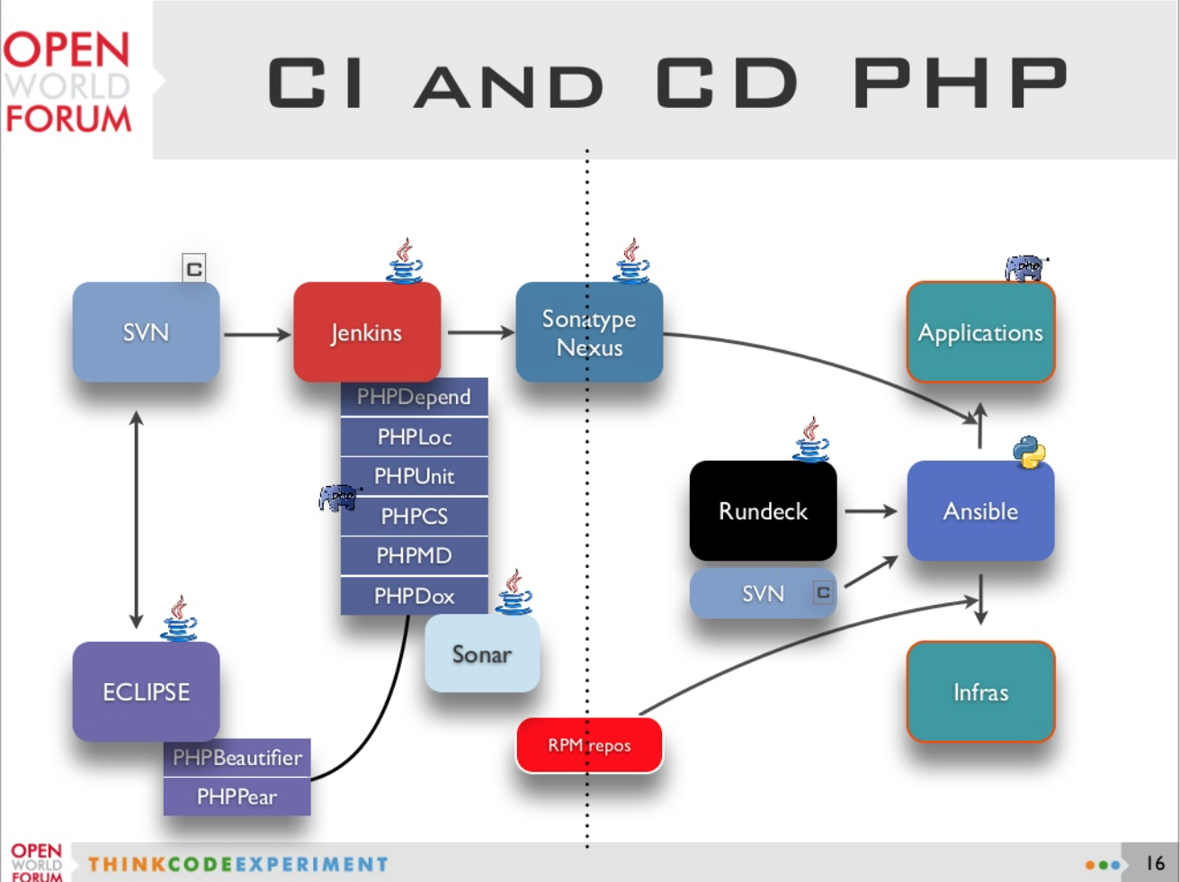
Nexus at Alter Way
Link to Presentation: Agnostic Continuous Delivery
file://localhost/Link%20to%20Presentation/%20%20Agnostic%20Continuous%20Delivery
Notes:
Continuous Delivery and DevOps Reference Architectures include many common tool choices. The most common tool choices we find in these reference architectures are: Eclipse, git, Cloudbees Jenkins / Atlassian Bamboo, Sonatype Nexus, Atlassian JIRA, SonarQube, Puppet, Chef, Rundeck, Maven / Ant / Gradle, Subversion (svn), Junit, LiveRebel, ServiceNow

Slide 13

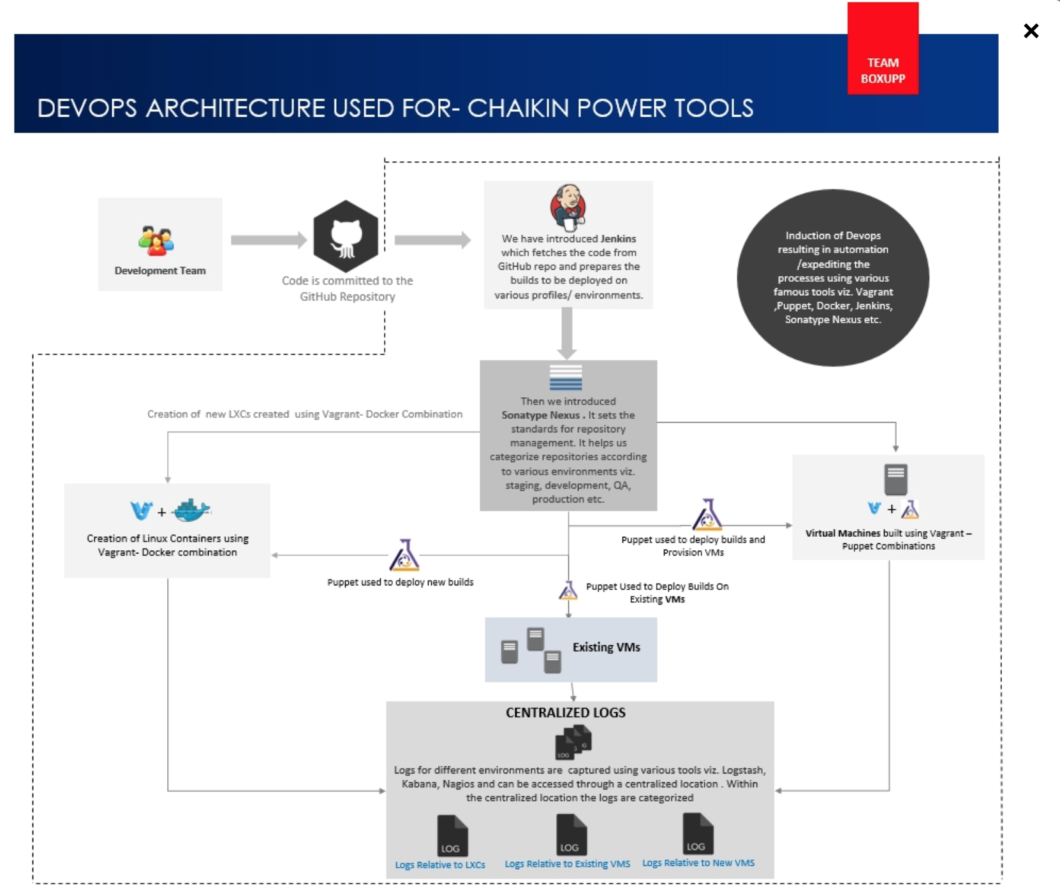
According to Boxupp
Link to Blog: A DevOps Perspective
http://www.boxupp.com/case-studies.html
Notes:
Continuous Delivery and DevOps Reference Architectures include many common tool choices. The most common tool choices we find in these reference architectures are: Eclipse, git, Cloudbees Jenkins / Atlassian Bamboo, Sonatype Nexus, Atlassian JIRA, SonarQube, Puppet, Chef, Rundeck, Maven / Ant / Gradle, Subversion (svn), Junit, LiveRebel, ServiceNow

Slide 14

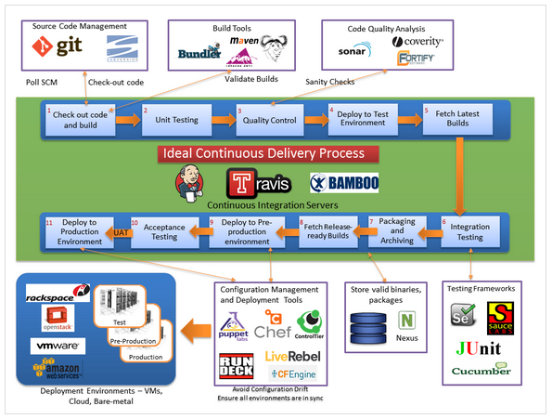
According to bogotobogo
Source: http://www.bogotobogo.com/DevOps/DevOps_CI_CD_Pipeline_Sample.php
Notes:
Continuous Delivery and DevOps Reference Architectures include many common tool choices. The most common tool choices we find in these reference architectures are: Eclipse, git, Cloudbees Jenkins / Atlassian Bamboo, Sonatype Nexus, Atlassian JIRA, SonarQube, Puppet, Chef, Rundeck, Maven / Ant / Gradle, Subversion (svn), Junit, LiveRebel, ServiceNow

Slide 15
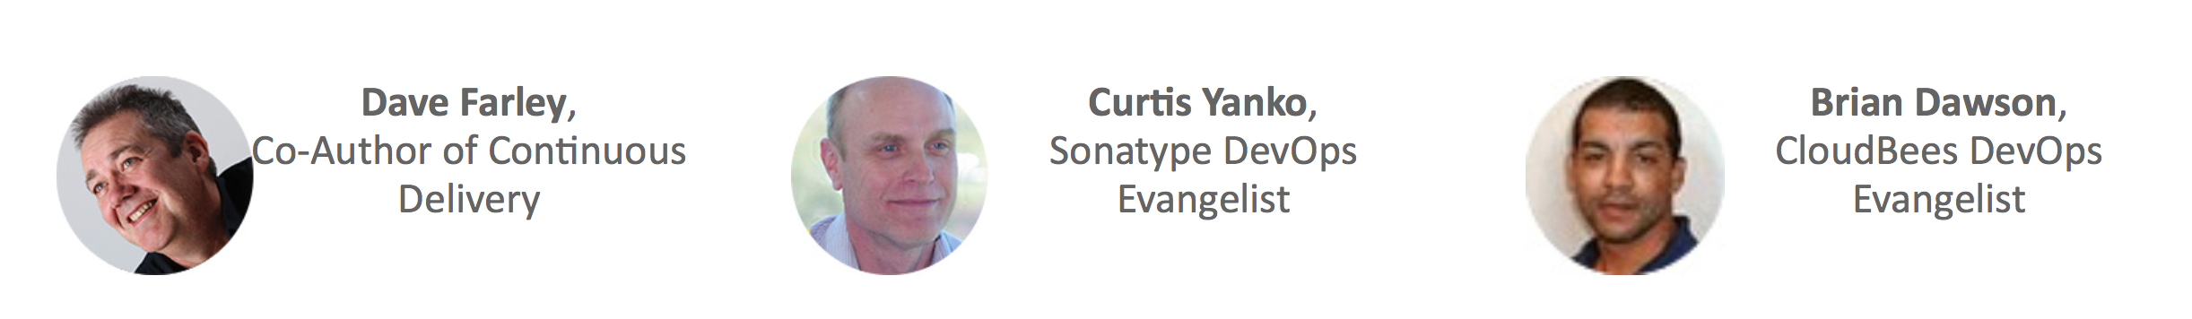

Learn from the Experts on October 1, 2015
RSVP Today
@ bit.ly/DevOpsTrio
For any enterprise implementation of DevOps or Continuous Delivery, it is important to have a reference architecture and pipeline defined. Learn from their best practices for securing new investments, driving process changes, and selecting tools to support their software factories.
Curtis Yanko
DevOps Coach,
Sonatype
Former Architecture Manager,
DevOps Center of Excellence
@OnCommit
Dave Farley
Founder and Director,
Continuous Delivery Ltd.
Co-Author of
Continuous Delivery
@davefarley77
Brian Dawson
DevOps Evangelist,
CloudBees
Former Manager,
Enterprise Agile Transformation Practice
CollabNet
@BrianVDawson

Slide 16
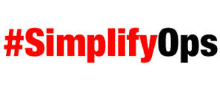
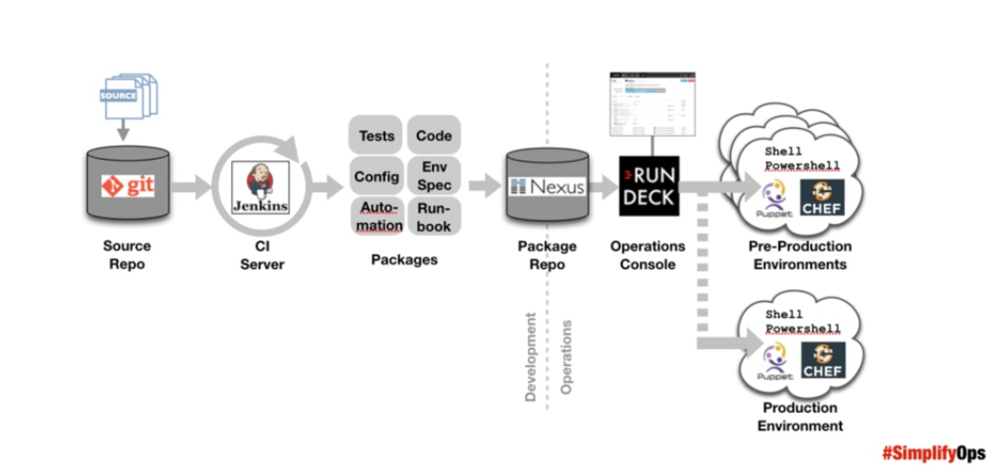
According to SimplifyOps
Source: DevOps & Security from an Enterprise Toolsmith's Perspective http://www.slideshare.net/dev2ops/devops-security
Notes:
Continuous Delivery and DevOps Reference Architectures include many common tool choices. The most common tool choices we find in these reference architectures are: Eclipse, git, Cloudbees Jenkins / Atlassian Bamboo, Sonatype Nexus, Atlassian JIRA, SonarQube, Puppet, Chef, Rundeck, Maven / Ant / Gradle, Subversion (svn), Junit, LiveRebel, ServiceNow

Slide 17

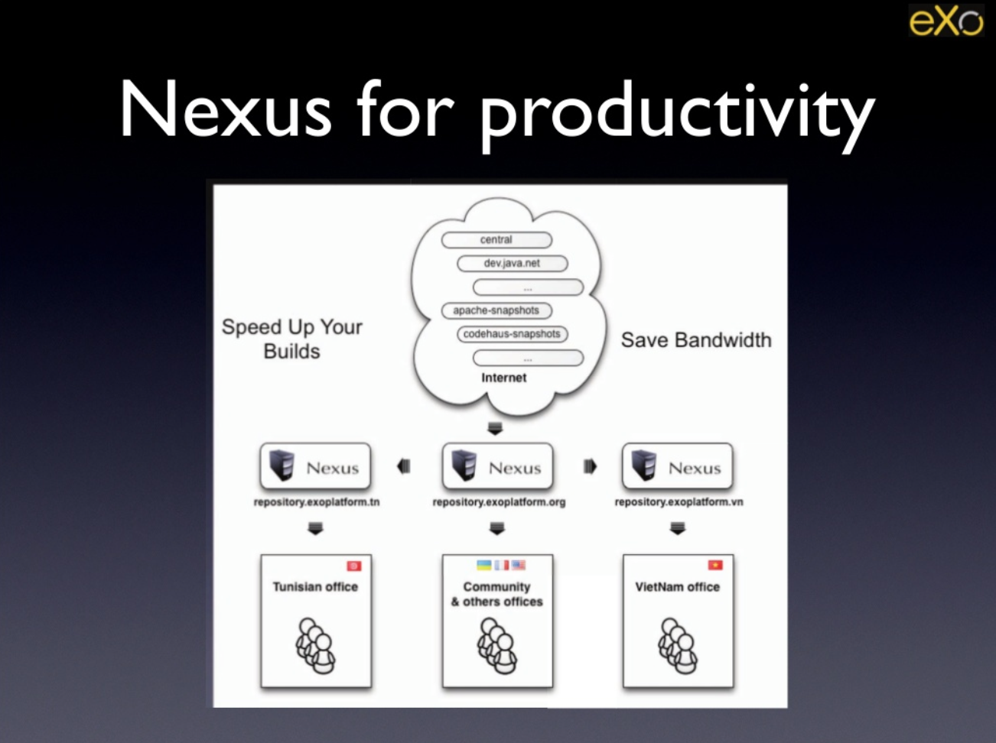
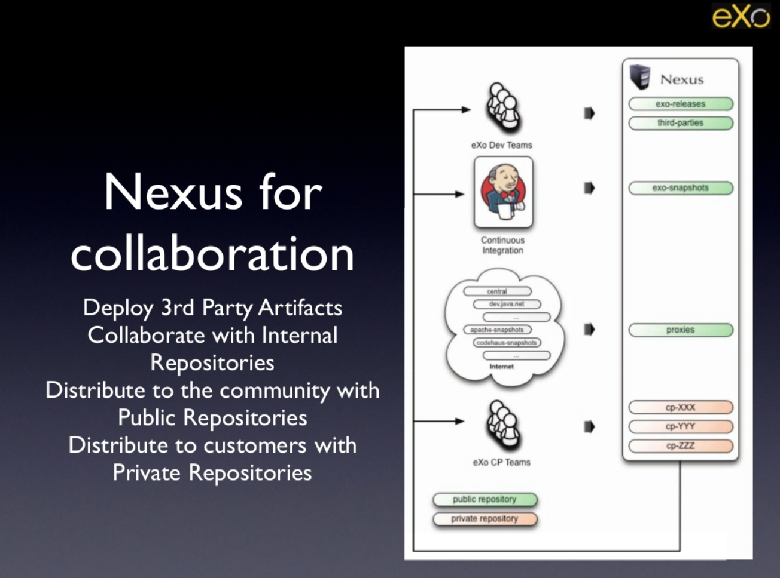
According to eXo Software
Link to Presentation: eXo Software Factory Overview
http://www.slideshare.net/exoplatform/exo-software-factory-overview-34489471?qid=3cfcaad2-05c4-45c6-aed1-cdffcd8dd195&v=default&b=&from_search=17
Notes:
Continuous Delivery and DevOps Reference Architectures include many common tool choices. The most common tool choices we find in these reference architectures are: Eclipse, git, Cloudbees Jenkins / Atlassian Bamboo, Sonatype Nexus, Atlassian JIRA, SonarQube, Puppet, Chef, Rundeck, Maven / Ant / Gradle, Subversion (svn), Junit, LiveRebel, ServiceNow

Slide 18

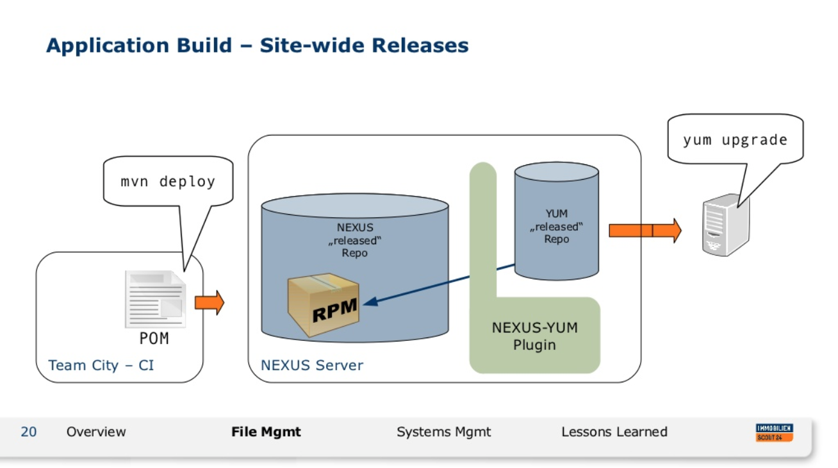
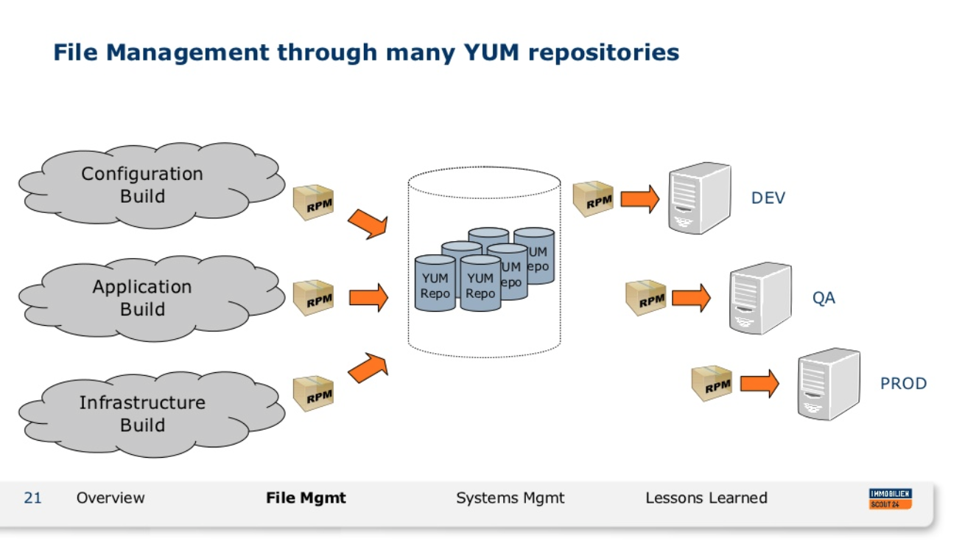
According to ImmobilienScout24
Link to Presentation: Be Fast or Stay Behind - Building a Continuous Delivery Platform
http://www.slideshare.net/schlomo/be-fast-or-stay-behind-building-a-continuous-delivery-platform?qid=3cfcaad2-05c4-45c6-aed1-cdffcd8dd195&v=default&b=&from_search=43
Notes:
Continuous Delivery and DevOps Reference Architectures include many common tool choices. The most common tool choices we find in these reference architectures are: Eclipse, git, Cloudbees Jenkins / Atlassian Bamboo, Sonatype Nexus, Atlassian JIRA, SonarQube, Puppet, Chef, Rundeck, Maven / Ant / Gradle, Subversion (svn), Junit, LiveRebel, ServiceNow

Slide 19

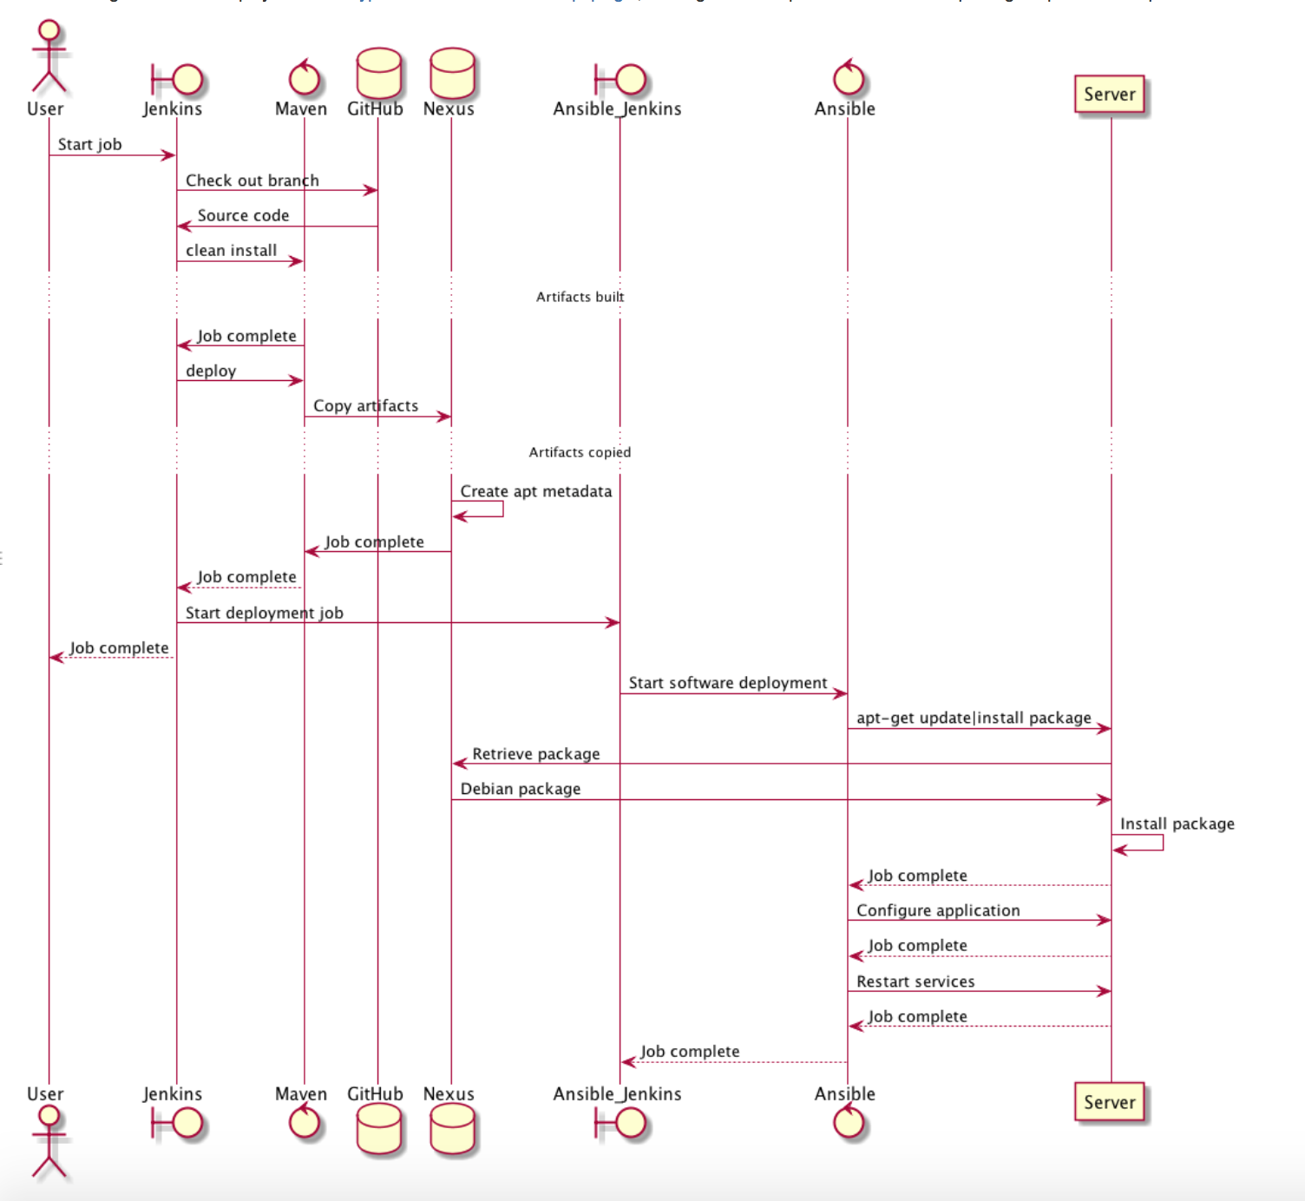
According to IHTSDO
Link to Blog: IHTSDO DevOps
https://confluence.ihtsdotools.org/display/DEVOPS/IHTSDO+DevOps
Notes:
Continuous Delivery and DevOps Reference Architectures include many common tool choices. The most common tool choices we find in these reference architectures are: Eclipse, git, Cloudbees Jenkins / Atlassian Bamboo, Sonatype Nexus, Atlassian JIRA, SonarQube, Puppet, Chef, Rundeck, Maven / Ant / Gradle, Subversion (svn), Junit, LiveRebel, ServiceNow

Slide 20

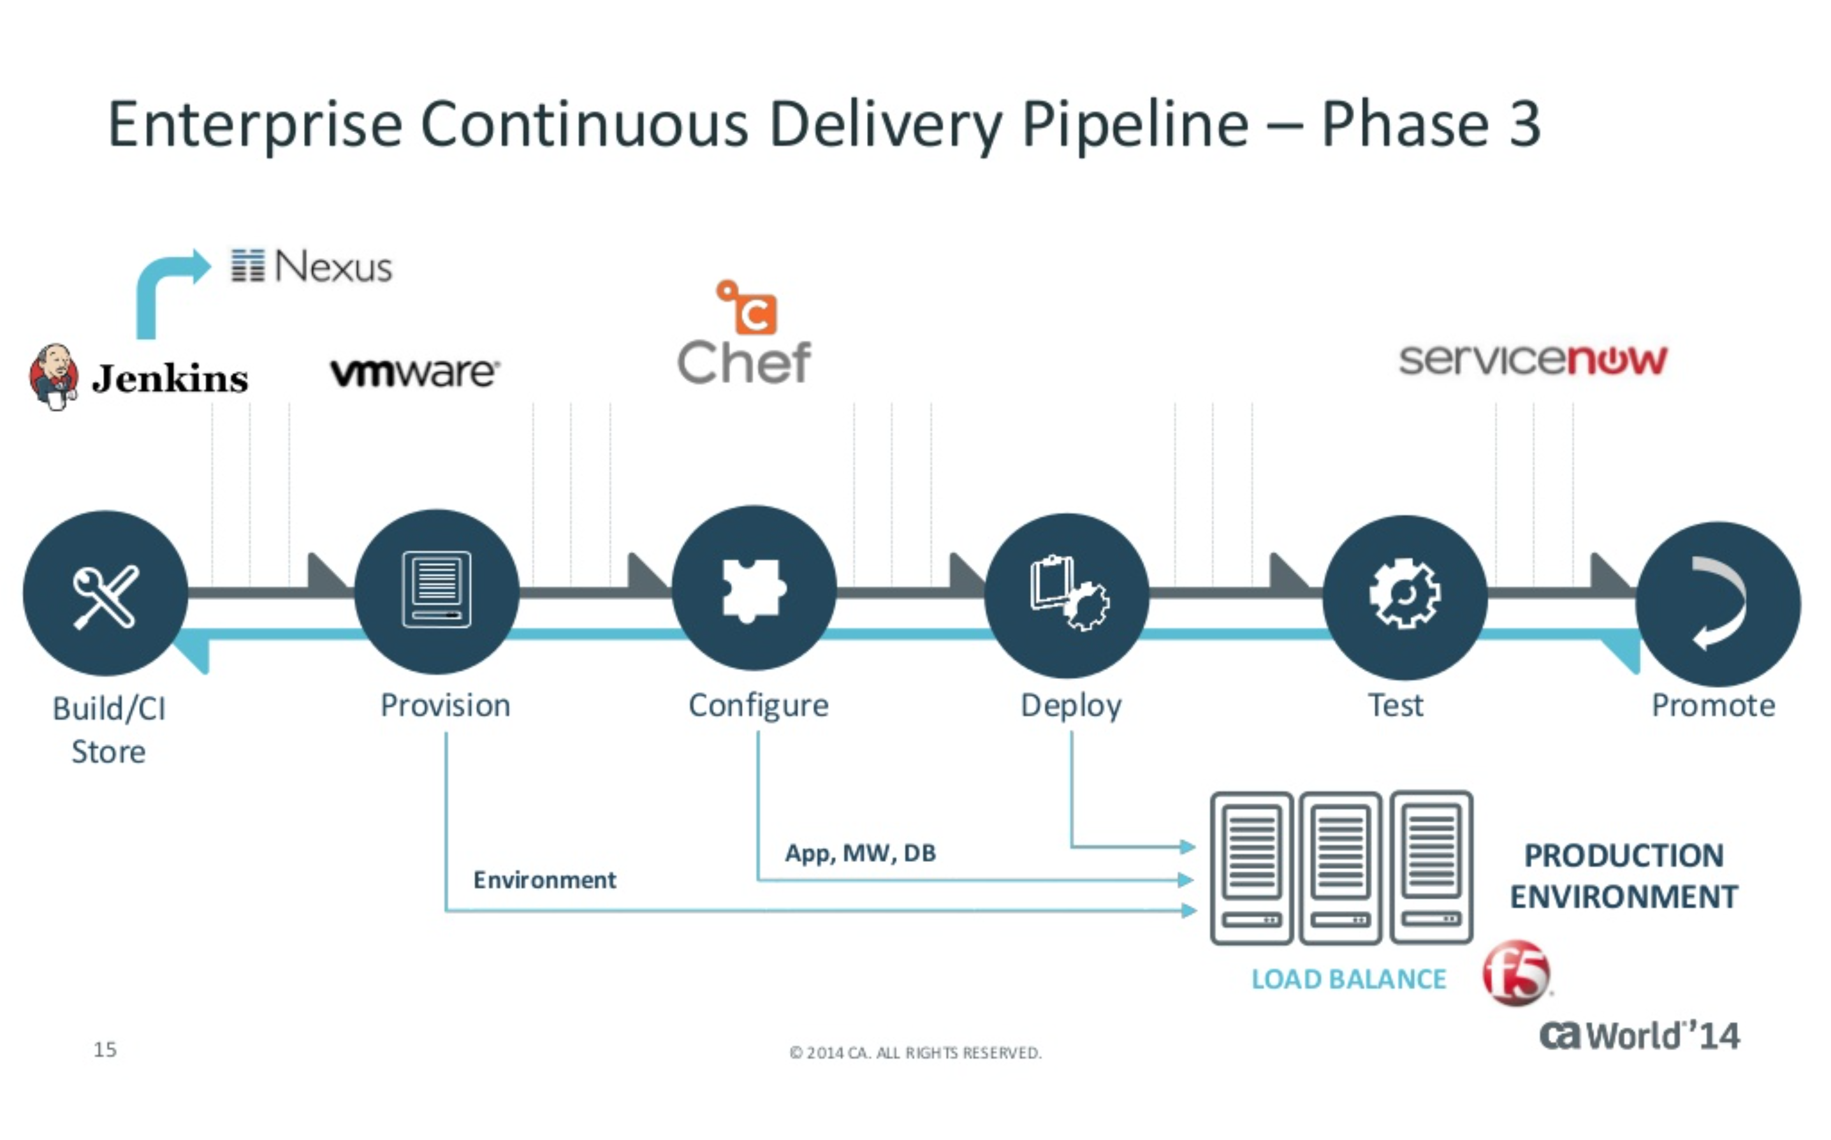
According to CA Technologies
Link to: What are the Cool Kids Doing With Continuous Delivery?
http://www.slideshare.net/CAinc/what-are-the-coolkidsdoingwithcontinuousdelivery?qid=4ae62edd-1432-4035-b8ca-b134d195888f&v=default&b=&from_search=1
Notes:
Continuous Delivery and DevOps Reference Architectures include many common tool choices. The most common tool choices we find in these reference architectures are: Eclipse, git, Cloudbees Jenkins / Atlassian Bamboo, Sonatype Nexus, Atlassian JIRA, SonarQube, Puppet, Chef, Rundeck, Maven / Ant / Gradle, Subversion (svn), Junit, LiveRebel, ServiceNow

Slide 21

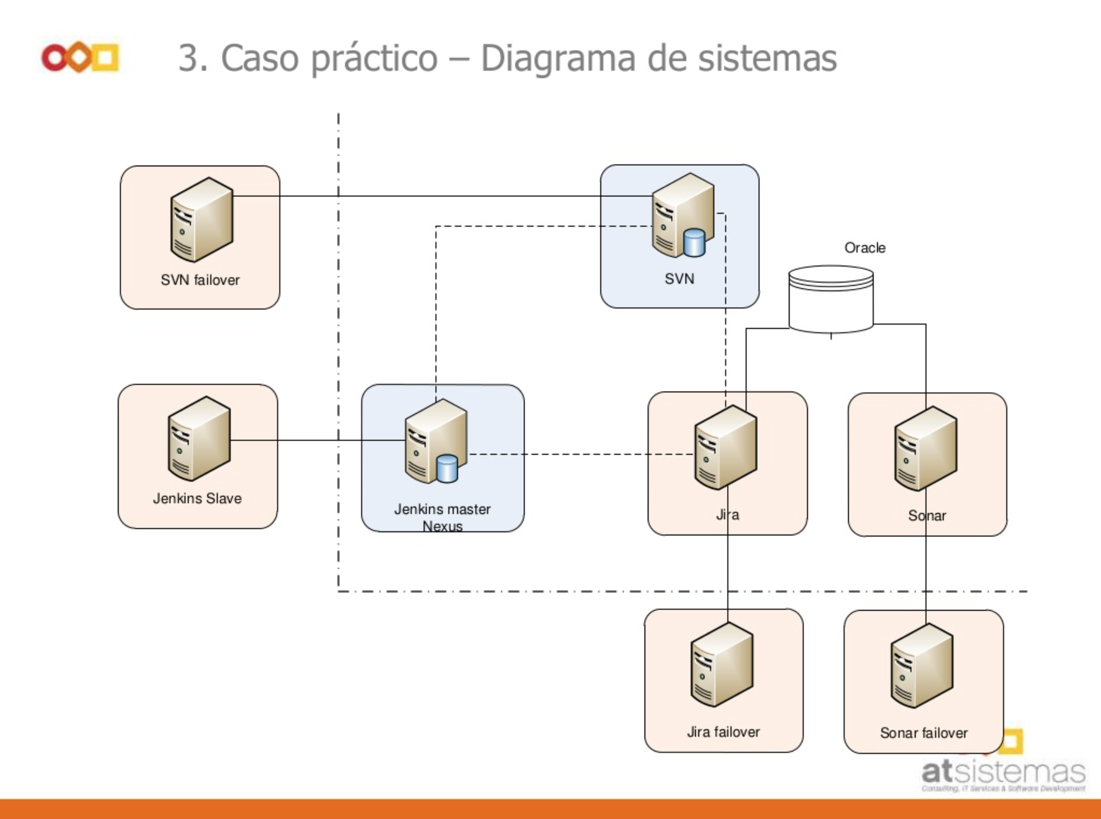
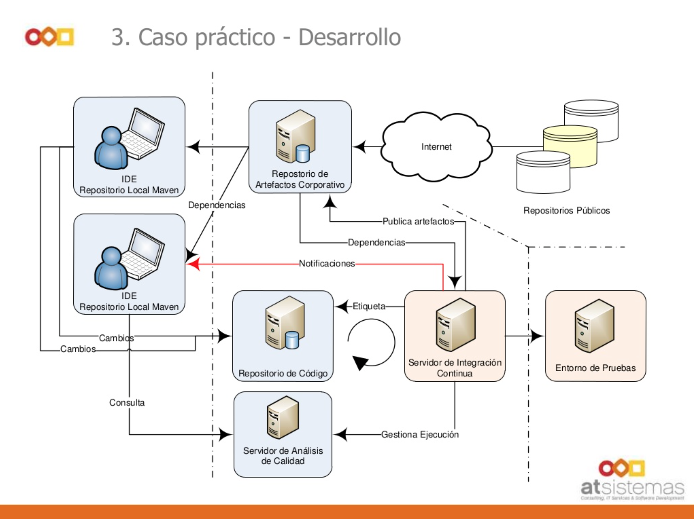
According to atSistemas
Link to Presentation: Presentación Integración Continua AUG Barcelona
http://es.slideshare.net/atSistemas/atsistemas-presentacin-integracin-continua-aug-barcelona-enero13
Notes:
Continuous Delivery and DevOps Reference Architectures include many common tool choices. The most common tool choices we find in these reference architectures are: Eclipse, git, Cloudbees Jenkins / Atlassian Bamboo, Sonatype Nexus, Atlassian JIRA, SonarQube, Puppet, Chef, Rundeck, Maven / Ant / Gradle, Subversion (svn), Junit, LiveRebel, ServiceNow

Slide 22

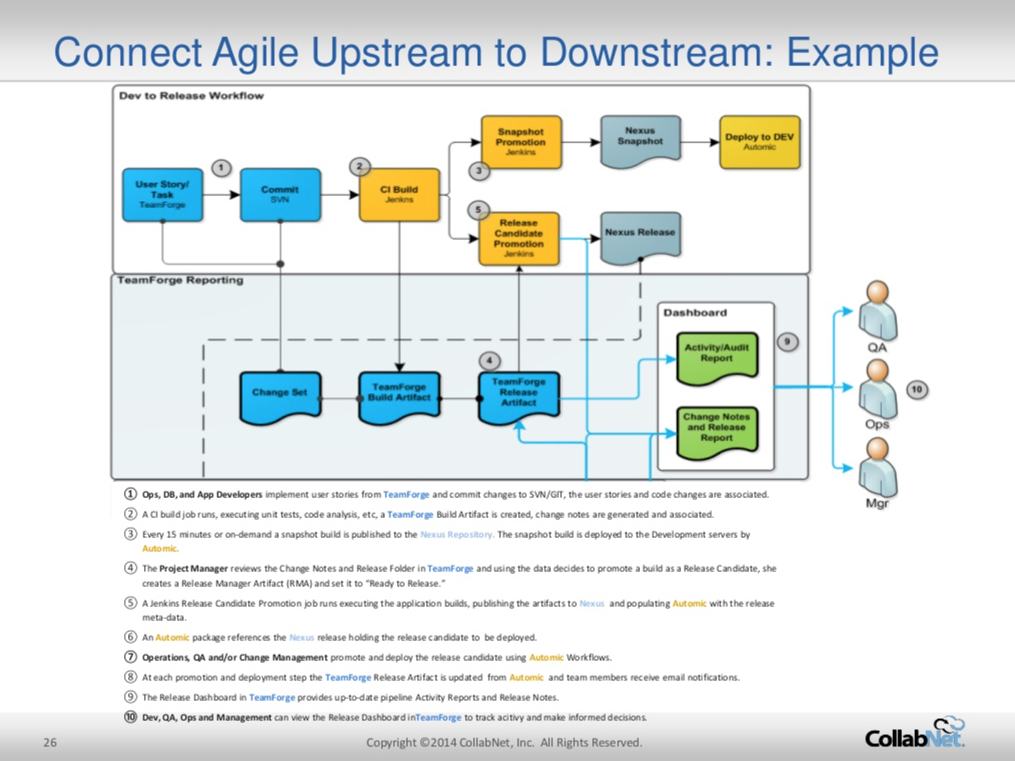
According to CollabNet
Link to Presentation: Linking Upstream and Downstream Agile
http://www.slideshare.net/collabNet/linking-upstream-and-downstream-agile?qid=3cfcaad2-05c4-45c6-aed1-cdffcd8dd195&v=default&b=&from_search=46
Notes:
Continuous Delivery and DevOps Reference Architectures include many common tool choices. The most common tool choices we find in these reference architectures are: Eclipse, git, Cloudbees Jenkins / Atlassian Bamboo, Sonatype Nexus, Atlassian JIRA, SonarQube, Puppet, Chef, Rundeck, Maven / Ant / Gradle, Subversion (svn), Junit, LiveRebel, ServiceNow

Slide 23

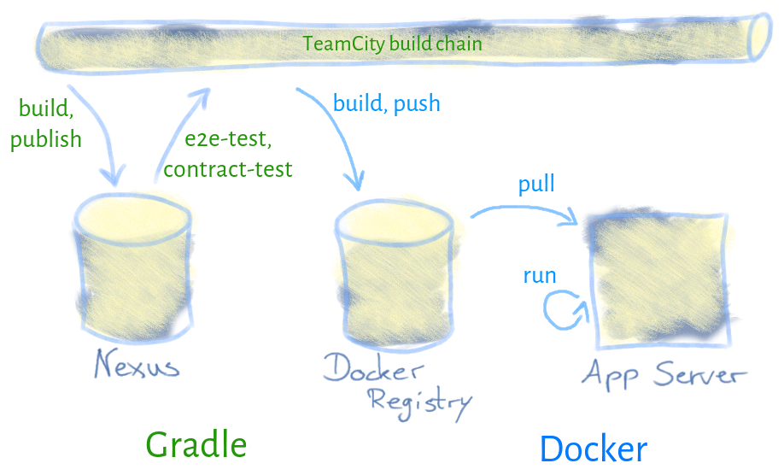
According to Hypoport AG
Link to Blog: Continuous Deployment with Gradle and Docker – Part 2
http://blog-it.hypoport.de/2014/10/15/continuous-deployment-with-gradle-and-docker-part-2/
Notes:
Continuous Delivery and DevOps Reference Architectures include many common tool choices. The most common tool choices we find in these reference architectures are: Eclipse, git, Cloudbees Jenkins / Atlassian Bamboo, Sonatype Nexus, Atlassian JIRA, SonarQube, Puppet, Chef, Rundeck, Maven / Ant / Gradle, Subversion (svn), Junit, LiveRebel, ServiceNow

Slide 24

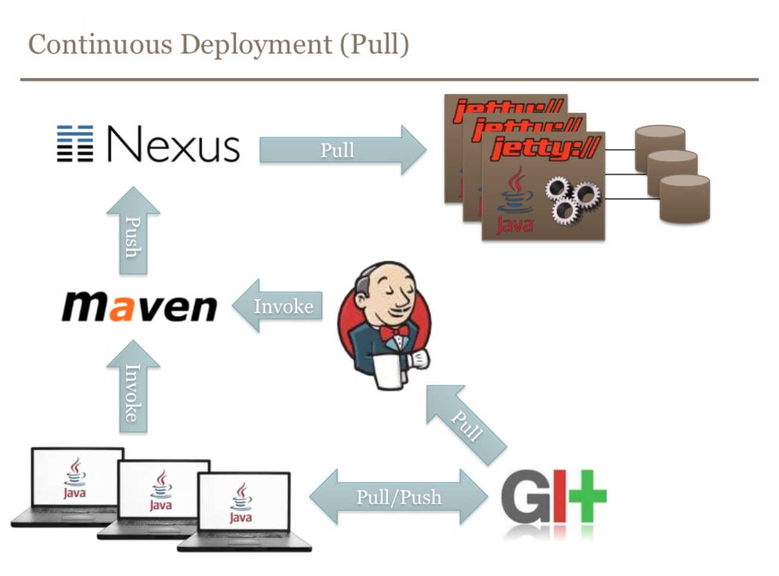
According to BEKK
Link to Presentation: Continuous Delivery
http://www.slideshare.net/steinim/continuous-delivery-8428863?qid=a11da3a5-5dc8-4dd3-a6d7-3b83a75283cc&v=default&b=&from_search=61
Notes:
Continuous Delivery and DevOps Reference Architectures include many common tool choices. The most common tool choices we find in these reference architectures are: Eclipse, git, Cloudbees Jenkins / Atlassian Bamboo, Sonatype Nexus, Atlassian JIRA, SonarQube, Puppet, Chef, Rundeck, Maven / Ant / Gradle, Subversion (svn), Junit, LiveRebel, ServiceNow

Slide 25
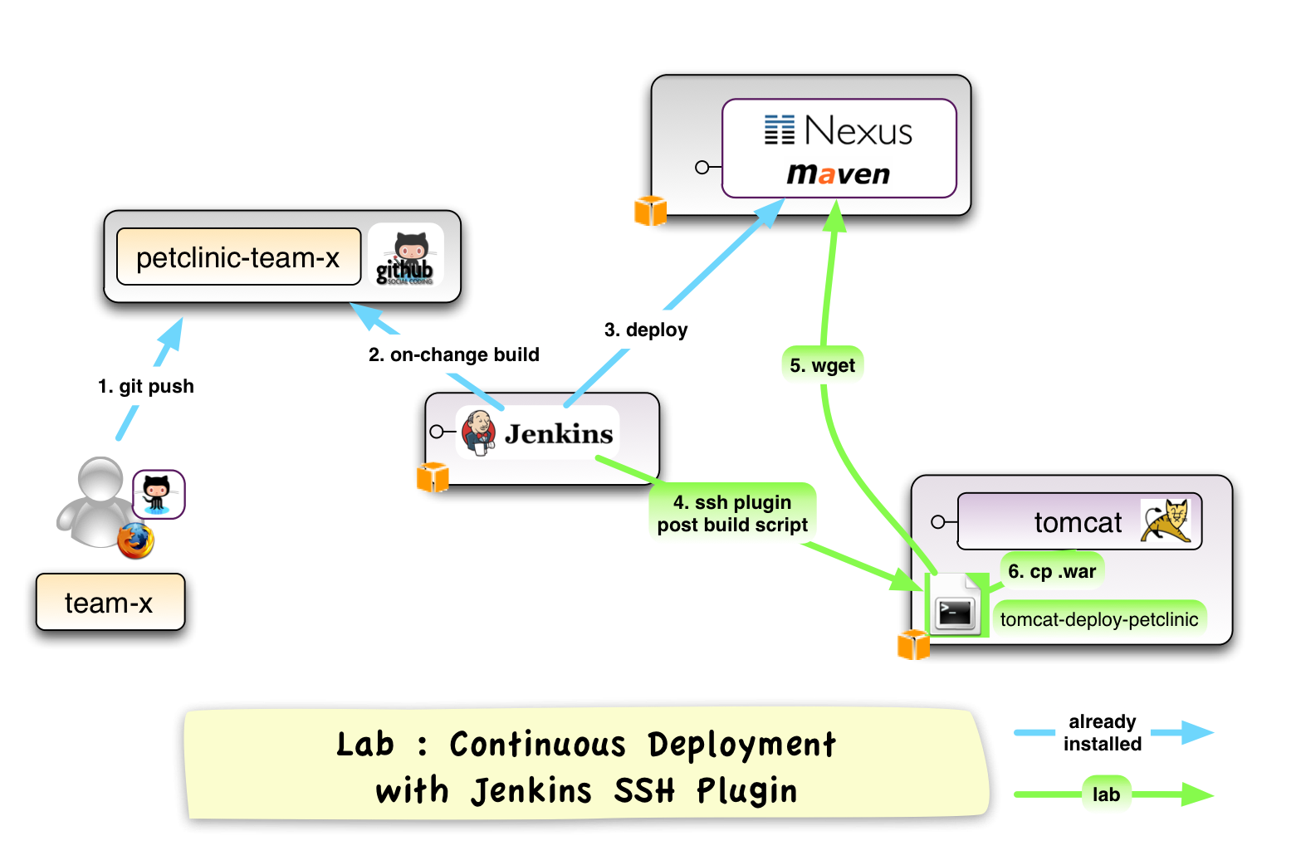
According to Xebia
Link to Presentation: Continuous Delivery Workshop
https://code.google.com/p/xebia-france/wiki/ContinuousDeliveryWorkshop

Slide 26

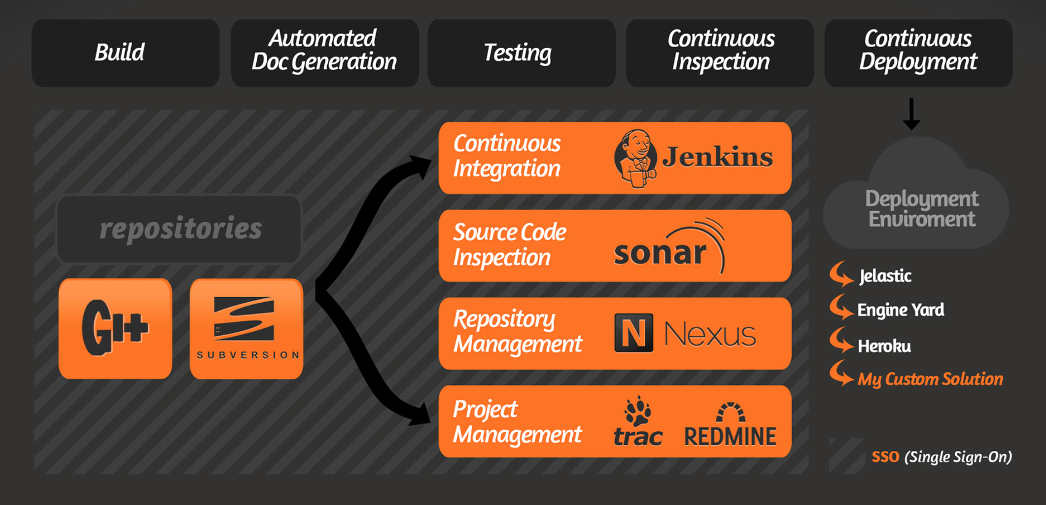
According to ClinkerHQ
Link to blog: http://blog.clinkerhq.com

Slide 27

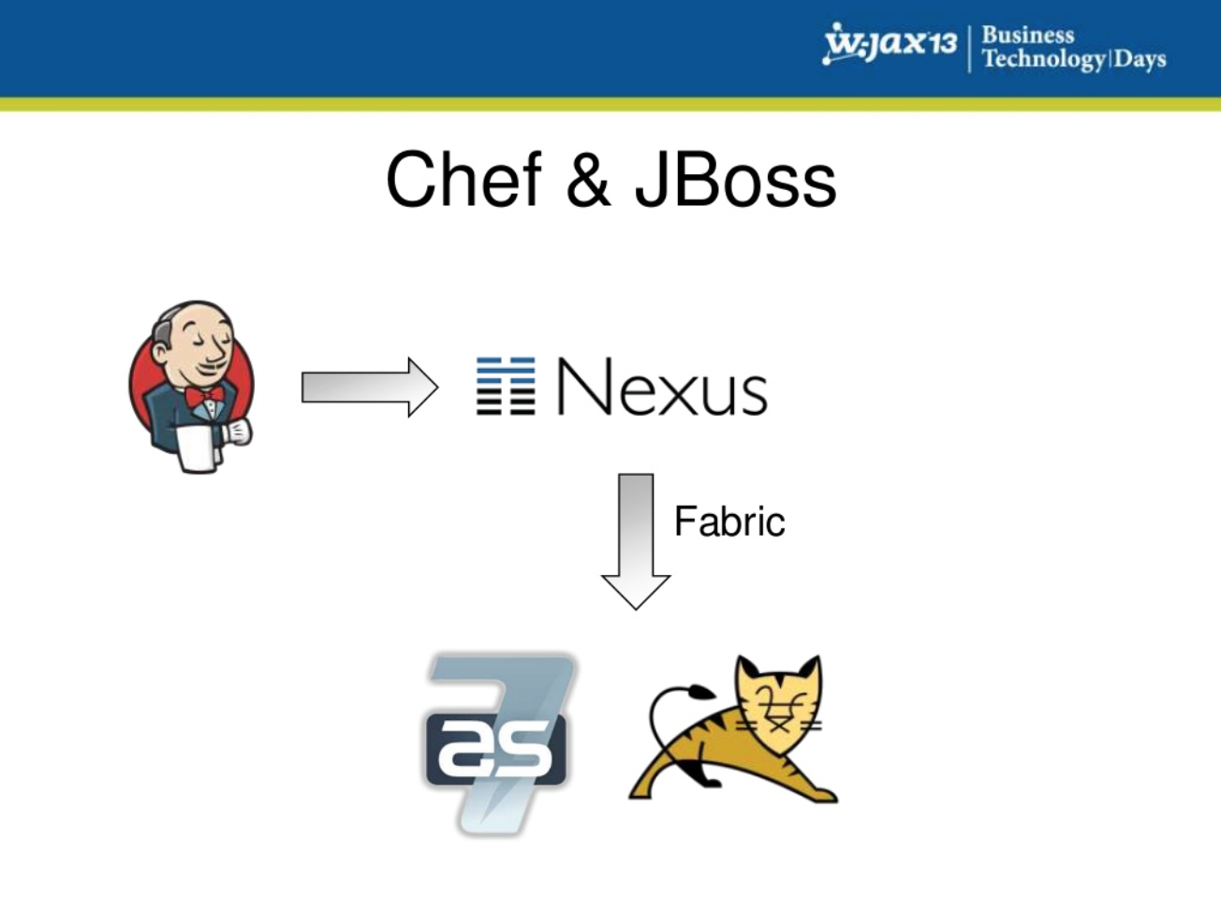
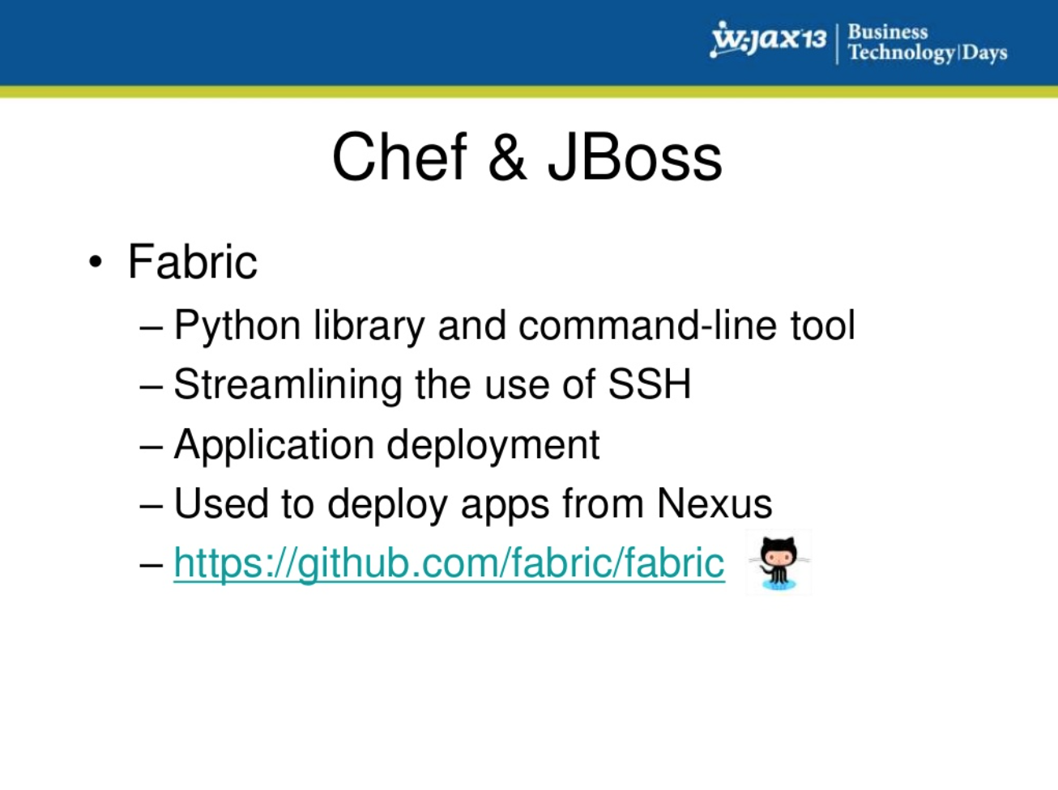
According to Zanox
Link to Presentation: Continuous Delivery and Infrastructure as Code
http://www.slideshare.net/saschamoellering/wjax-2013?qid=c42dc952-bd20-4f9e-a30e-6ccbf69ae9a4&v=qf1&b=&from_search=32
Notes:
Continuous Delivery and DevOps Reference Architectures include many common tool choices. The most common tool choices we find in these reference architectures are: Eclipse, git, Cloudbees Jenkins / Atlassian Bamboo, Sonatype Nexus, Atlassian JIRA, SonarQube, Puppet, Chef, Rundeck, Maven / Ant / Gradle, Subversion (svn), Junit, LiveRebel, ServiceNow

Slide 28

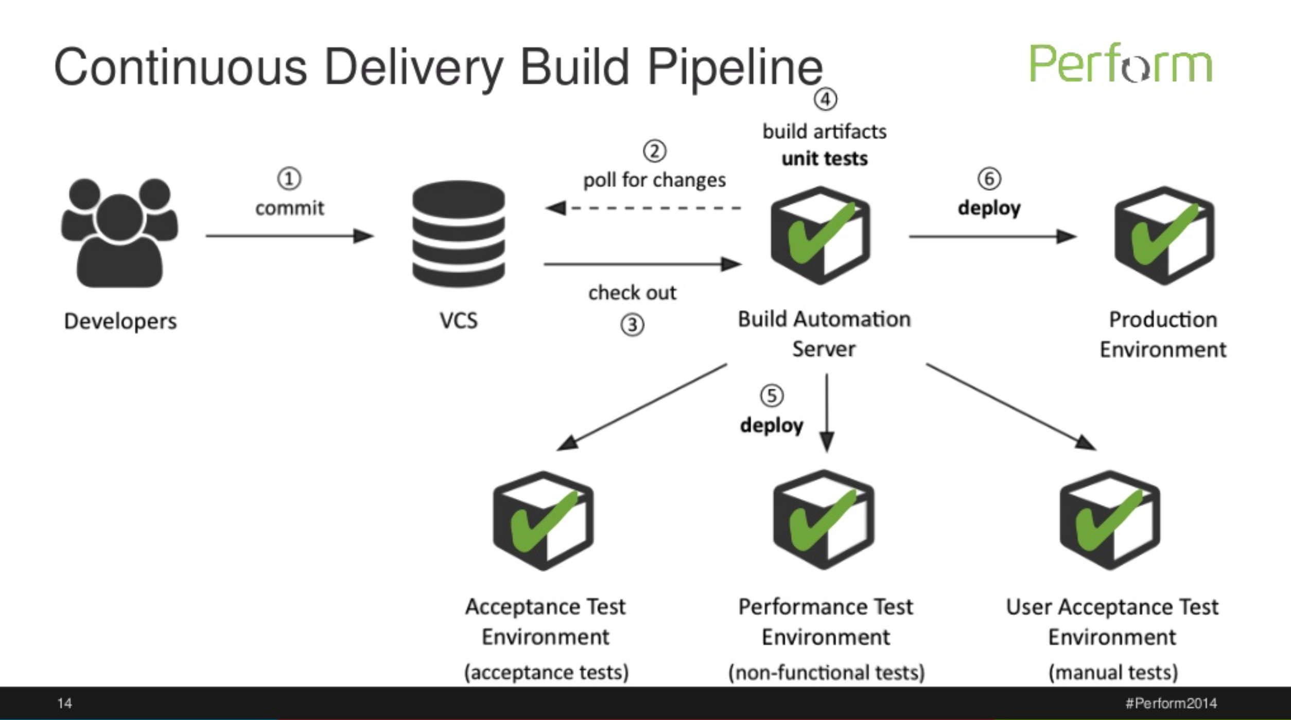
According to Dynatrace
Link: https://www.slideshare.net/slideshow/embed_code/40038166
Notes:
Continuous Delivery and DevOps Reference Architectures include many common tool choices. The most common tool choices we find in these reference architectures are: Eclipse, git, Cloudbees Jenkins / Atlassian Bamboo, Sonatype Nexus, Atlassian JIRA, SonarQube, Puppet, Chef, Rundeck, Maven / Ant / Gradle, Subversion (svn), Junit, LiveRebel, ServiceNow

Slide 29
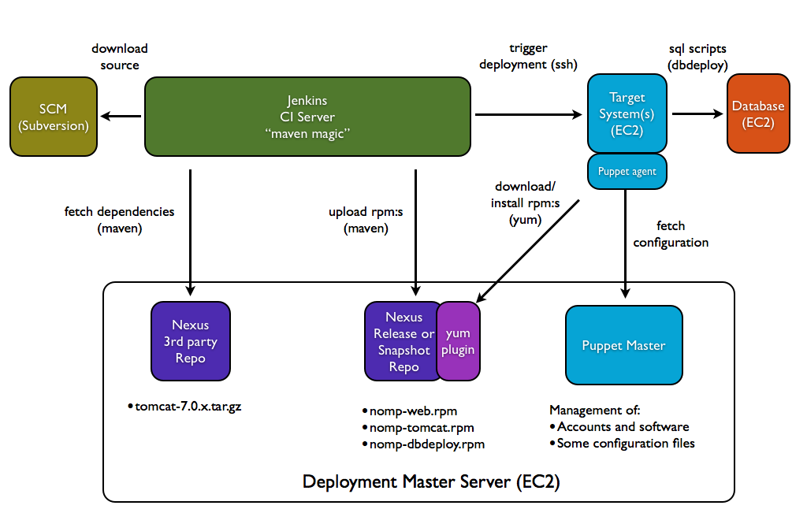
According to Stefan Norberg
Source: https://stnor.wordpress.com/tag/dbdeploy/

Slide 30

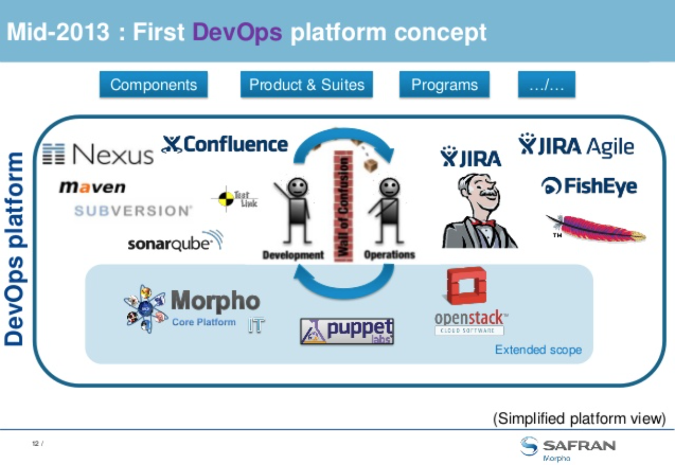
Nexus at Morpho
Source: http://www.slideshare.net/JeanCharlesJOREL/20141207-dev-ops-infrastructure-service-line-devops-approach-timeline

Slide 31
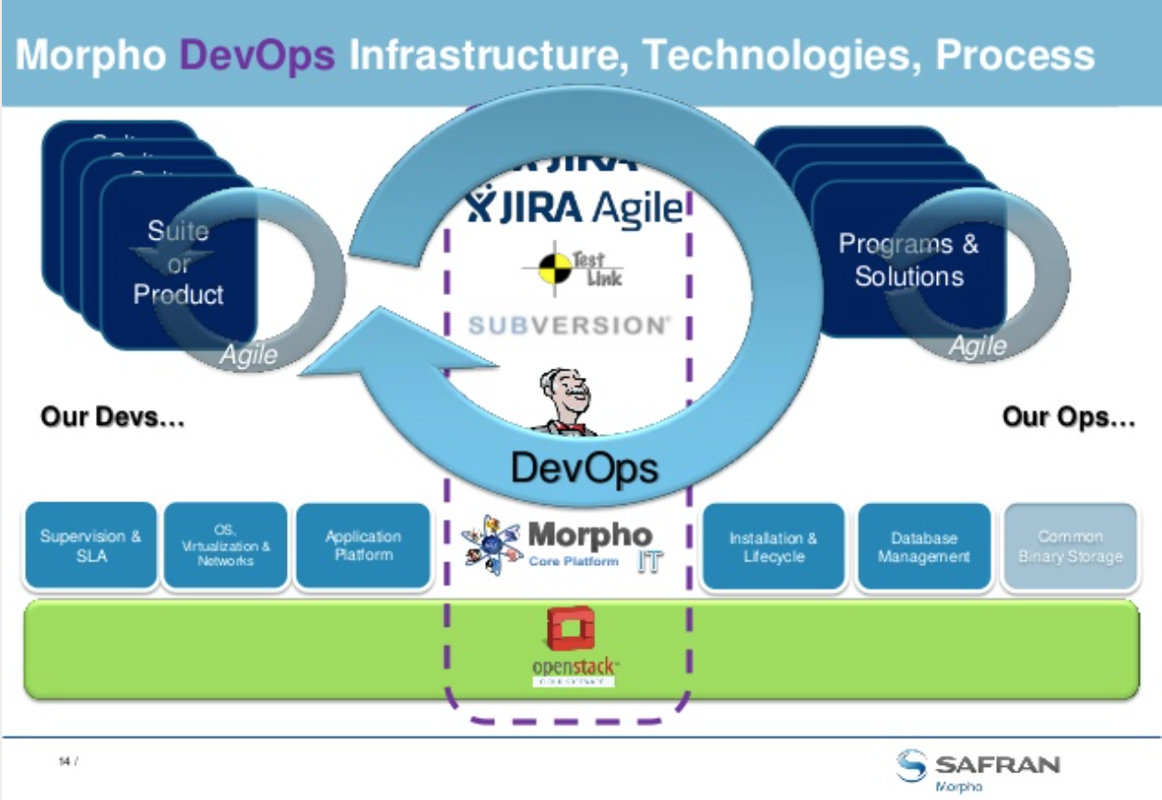
According to Morpho
Source: http://www.slideshare.net/JeanCharlesJOREL/20141207-dev-ops-infrastructure-service-line-devops-approach-timeline

Slide 32
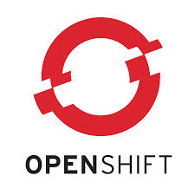
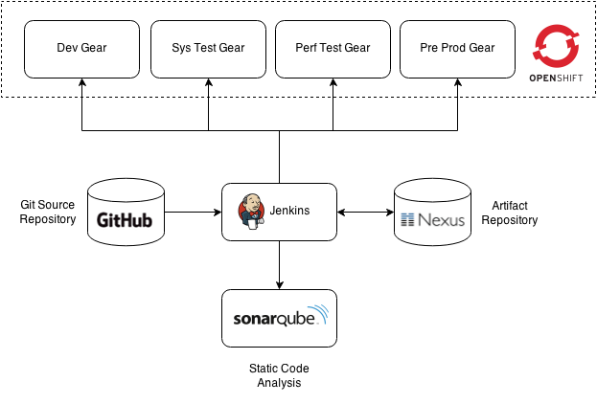
According to OPENSHIFT
Source: https://github.com/siamaksade/openshift-cd-demo
Notes:
Continuous Delivery and DevOps Reference Architectures include many common tool choices. The most common tool choices we find in these reference architectures are: Eclipse, git, Cloudbees Jenkins / Atlassian Bamboo, Sonatype Nexus, Atlassian JIRA, SonarQube, Puppet, Chef, Rundeck, Maven / Ant / Gradle, Subversion (svn), Junit, LiveRebel, ServiceNow

Slide 33

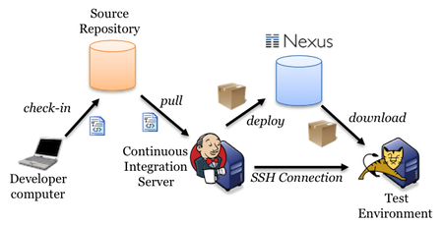
According to akquinet
Link to Blog: JUMPING INTO CONTINUOUS DELIVERY WITH JENKINS AND SSH
http://blog.akquinet.de/2012/01/10/jumping-into-continuous-delivery-with-jenkins-and-ssh/
Notes:
Continuous Delivery and DevOps Reference Architectures include many common tool choices. The most common tool choices we find in these reference architectures are: Eclipse, git, Cloudbees Jenkins / Atlassian Bamboo, Sonatype Nexus, Atlassian JIRA, SonarQube, Puppet, Chef, Rundeck, Maven / Ant / Gradle, Subversion (svn), Junit, LiveRebel, ServiceNow

Slide 34

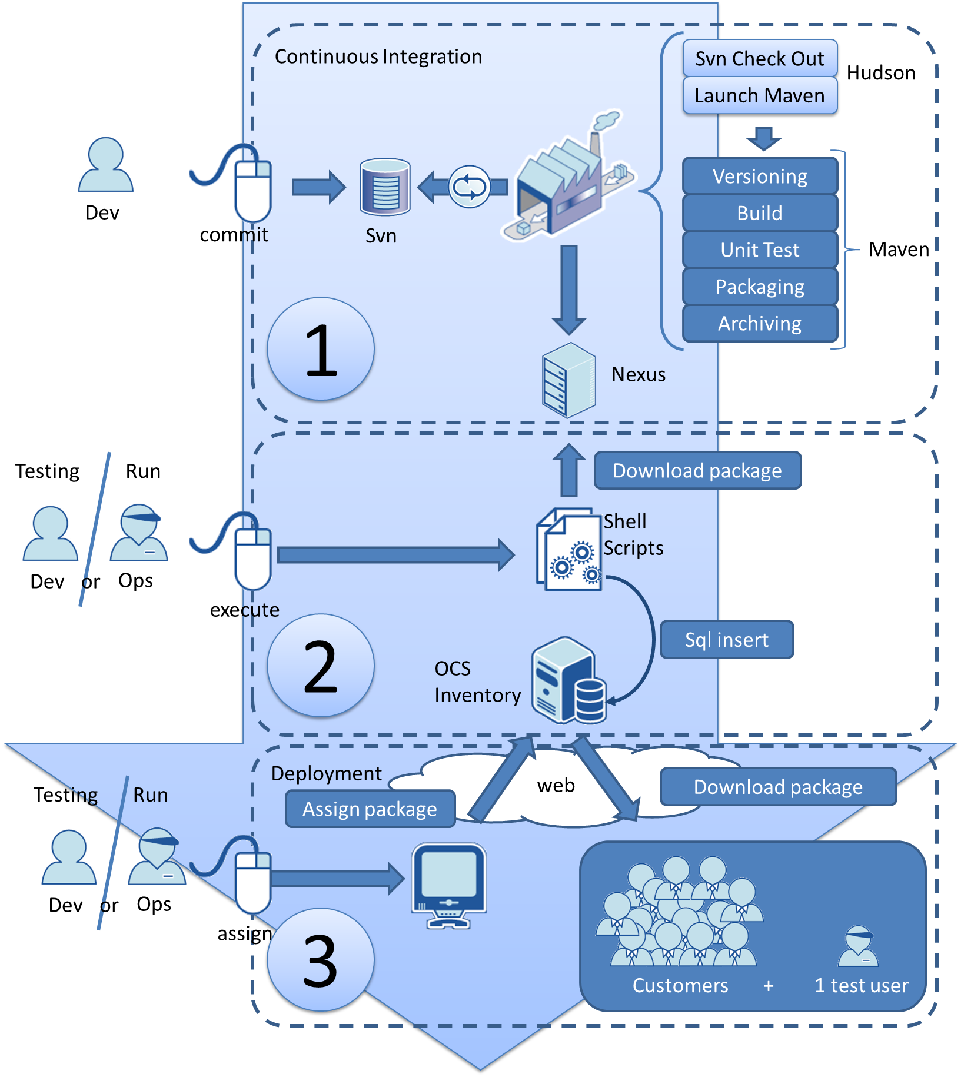
According to OCTO
Link to Blog: Continuous Delivery: How do we deliver in 3 clicks to 7000 machines?
http://blog.octo.com/en/continuous-delivery-how-do-we-deliver-in-3-clicks-to-7000-machines/
Notes:
Continuous Delivery and DevOps Reference Architectures include many common tool choices. The most common tool choices we find in these reference architectures are: Eclipse, git, Cloudbees Jenkins / Atlassian Bamboo, Sonatype Nexus, Atlassian JIRA, SonarQube, Puppet, Chef, Rundeck, Maven / Ant / Gradle, Subversion (svn), Junit, LiveRebel, ServiceNow

Slide 35
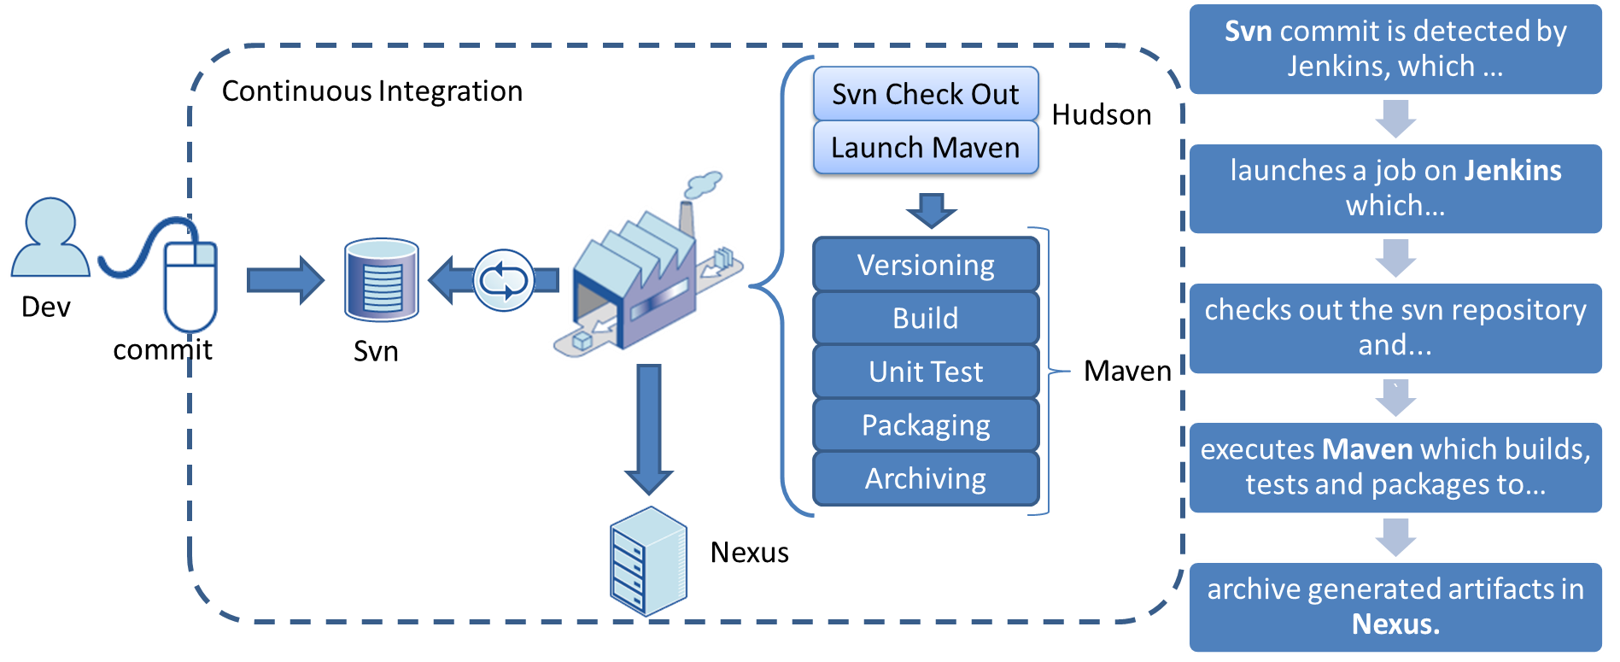
According to OCTO
Link to Blog: Continuous Delivery: How do we deliver in 3 clicks to 7000 machines?
http://blog.octo.com/en/continuous-delivery-how-do-we-deliver-in-3-clicks-to-7000-machines/
Notes:
Continuous Delivery and DevOps Reference Architectures include many common tool choices. The most common tool choices we find in these reference architectures are: Eclipse, git, Cloudbees Jenkins / Atlassian Bamboo, Sonatype Nexus, Atlassian JIRA, SonarQube, Puppet, Chef, Rundeck, Maven / Ant / Gradle, Subversion (svn), Junit, LiveRebel, ServiceNow

Slide 36
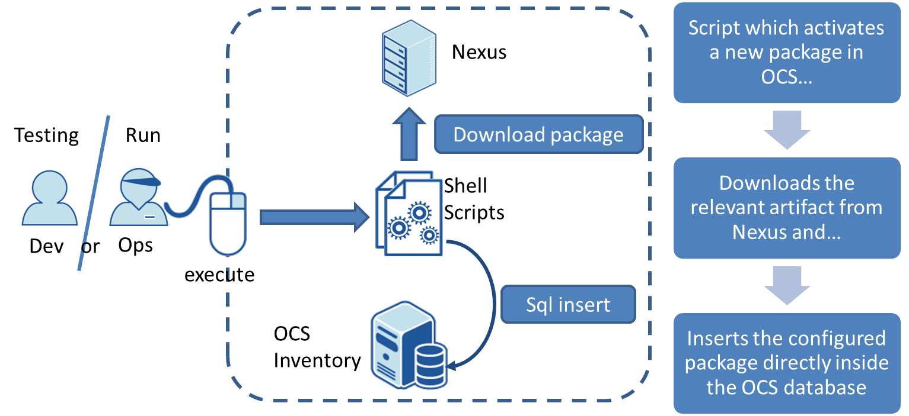
According to OCTO
Link to Blog: Continuous Delivery: How do we deliver in 3 clicks to 7000 machines?
http://blog.octo.com/en/continuous-delivery-how-do-we-deliver-in-3-clicks-to-7000-machines/
Notes:
Continuous Delivery and DevOps Reference Architectures include many common tool choices. The most common tool choices we find in these reference architectures are: Eclipse, git, Cloudbees Jenkins / Atlassian Bamboo, Sonatype Nexus, Atlassian JIRA, SonarQube, Puppet, Chef, Rundeck, Maven / Ant / Gradle, Subversion (svn), Junit, LiveRebel, ServiceNow

Slide 37
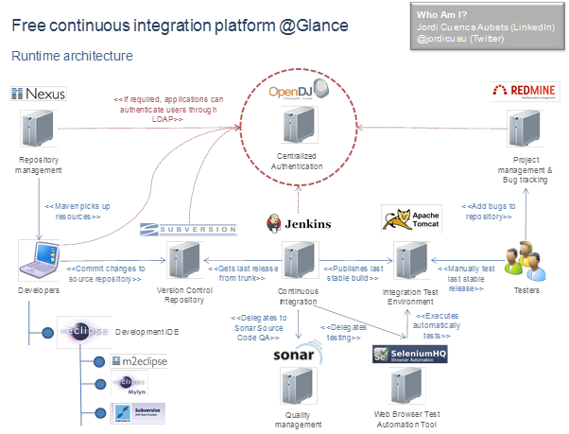
According to Jordi Cuenca-Aubets
Link to Blog: Free Continuous Integration Platform at a Glance
http://www.sonatype.org/nexus/2015/03/20/free-continuous-integration-platform-at-a-glance/
Notes:
Continuous Delivery and DevOps Reference Architectures include many common tool choices. The most common tool choices we find in these reference architectures are: Eclipse, git, Cloudbees Jenkins / Atlassian Bamboo, Sonatype Nexus, Atlassian JIRA, SonarQube, Puppet, Chef, Rundeck, Maven / Ant / Gradle, Subversion (svn), Junit, LiveRebel, ServiceNow

Slide 38

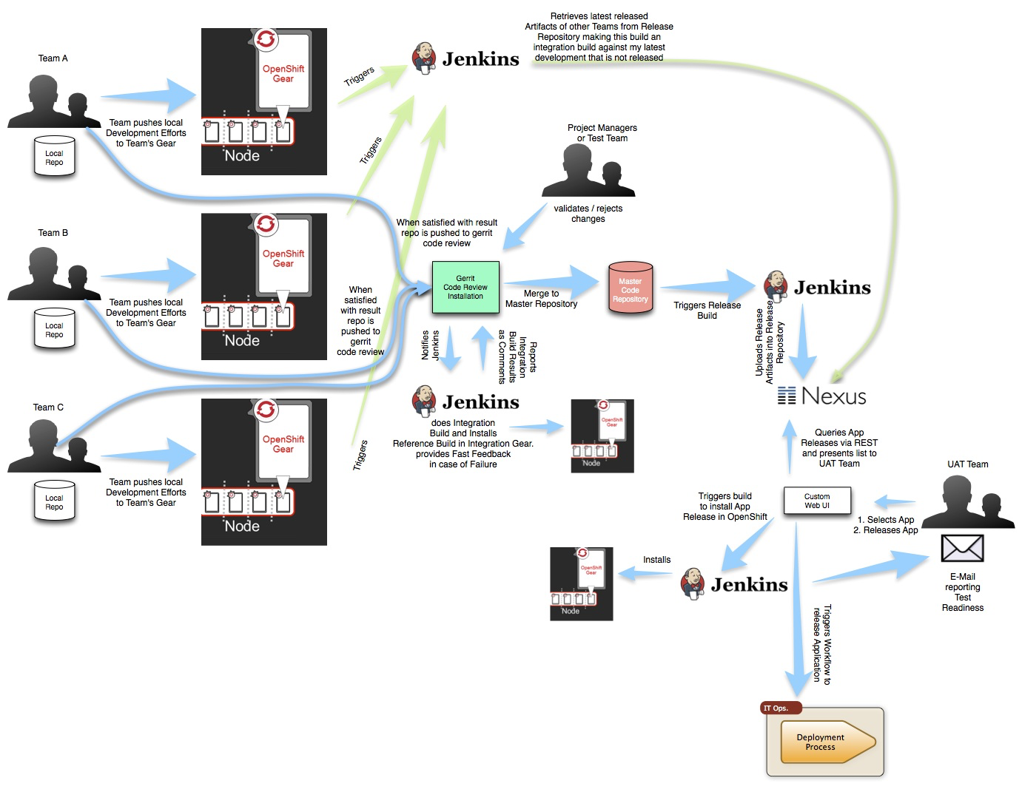
According to Open Sourcerers
Link to Blog: Continuous Delivery using PaaS
http://www.opensourcerers.org/continuous-delivery-using-paas/
Notes:
Continuous Delivery and DevOps Reference Architectures include many common tool choices. The most common tool choices we find in these reference architectures are: Eclipse, git, Cloudbees Jenkins / Atlassian Bamboo, Sonatype Nexus, Atlassian JIRA, SonarQube, Puppet, Chef, Rundeck, Maven / Ant / Gradle, Subversion (svn), Junit, LiveRebel, ServiceNow

Slide 39
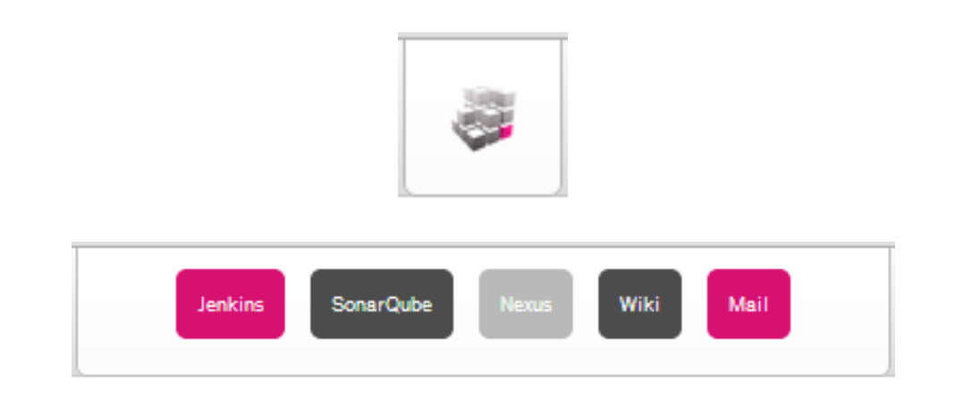
According to Michael Rumpf
Link to Blog: Integrating Jenkins, SonarQube, and Nexus
http://michael.rumpfonline.de
Notes:
Continuous Delivery and DevOps Reference Architectures include many common tool choices. The most common tool choices we find in these reference architectures are: Eclipse, git, Cloudbees Jenkins / Atlassian Bamboo, Sonatype Nexus, Atlassian JIRA, SonarQube, Puppet, Chef, Rundeck, Maven / Ant / Gradle, Subversion (svn), Junit, LiveRebel, ServiceNow

Slide 40
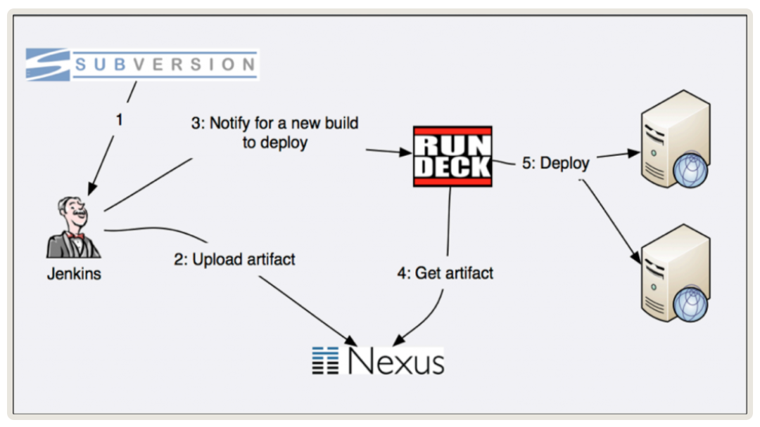
According to Cardlife
Link to Blog: How I use Rundeck, Python Fabric, Ansible and Chef to provide automated self-service deployment strategy to the teams
http://cardlife.us/how-i-use-rundeck-the-automation-augestion-to-provide-self-service-deployment-stratagem/

Slide 41
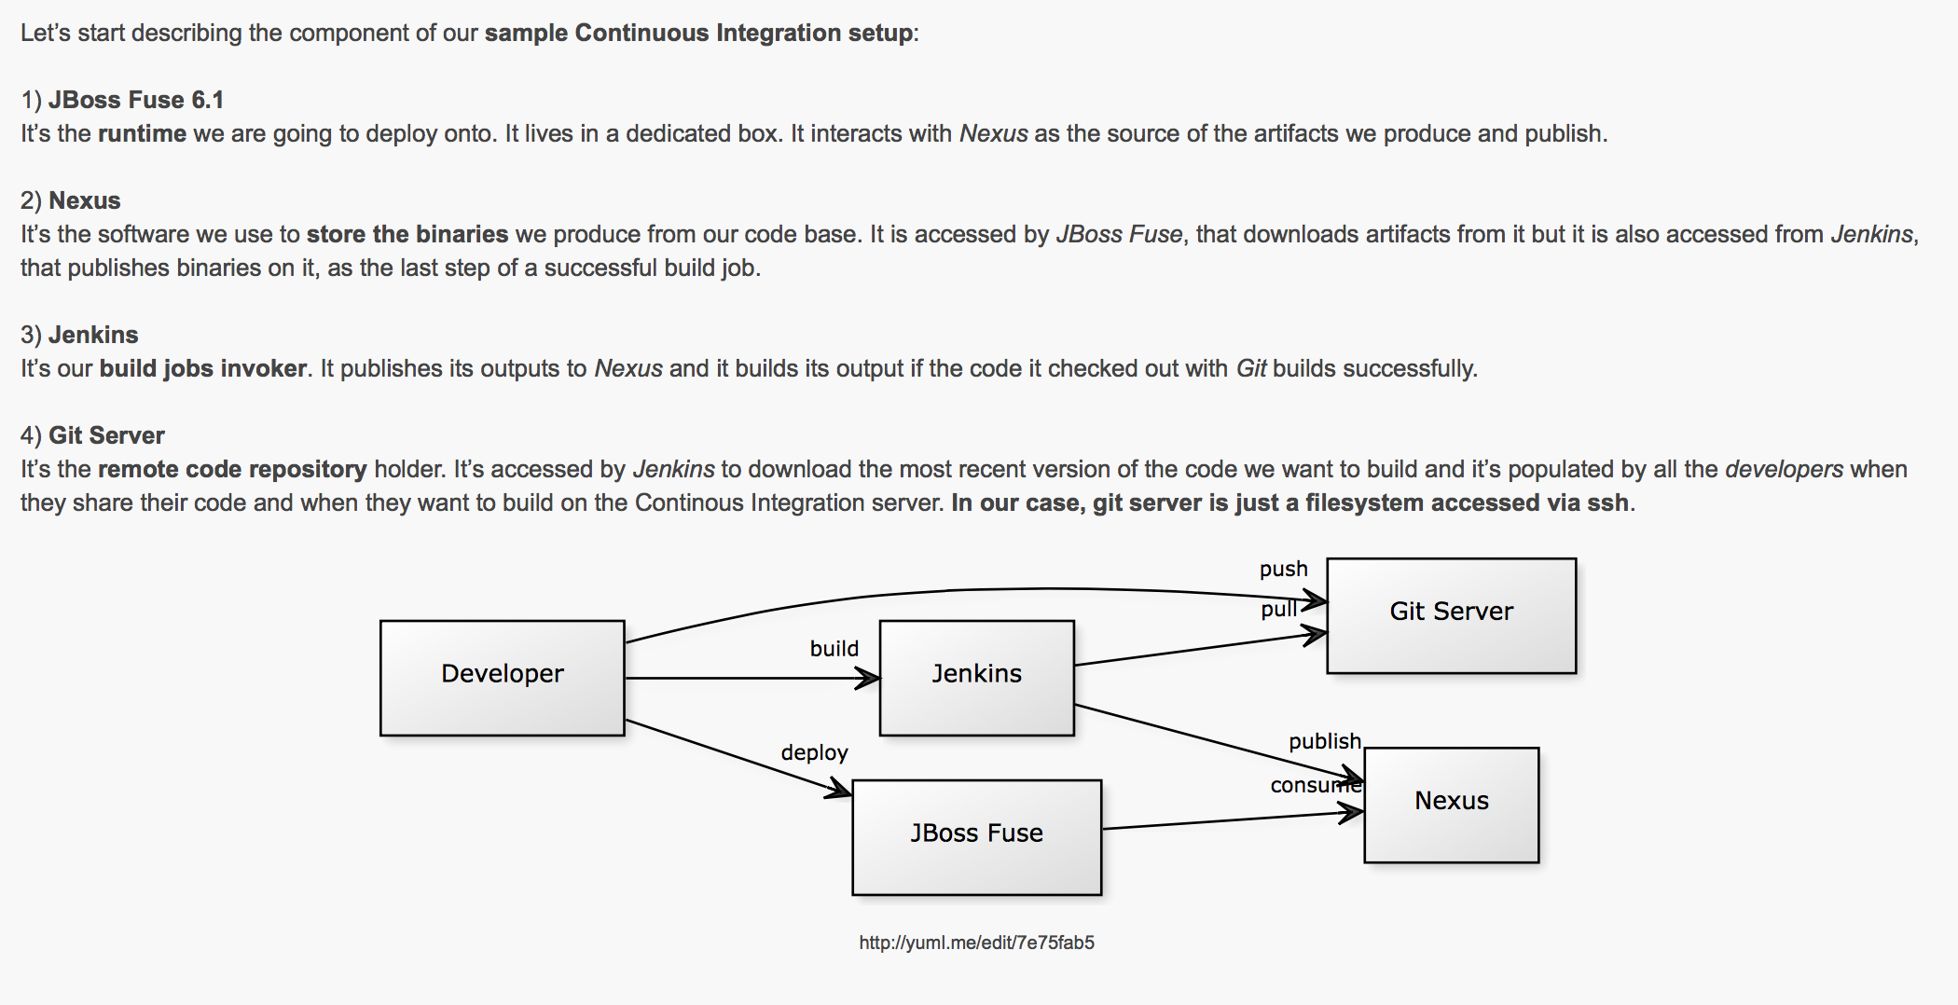
According to Paolo Antinori, RedHat
Link to Blog: Continuous Integration with JBoss Fuse, Jenkins and Nexus
http://giallone.blogspot.com/2014/05/continuous-integration-with-jboss-fuse.html
Notes:
Continuous Delivery and DevOps Reference Architectures include many common tool choices. The most common tool choices we find in these reference architectures are: Eclipse, git, Cloudbees Jenkins / Atlassian Bamboo, Sonatype Nexus, Atlassian JIRA, SonarQube, Puppet, Chef, Rundeck, Maven / Ant / Gradle, Subversion (svn), Junit, LiveRebel, ServiceNow

Slide 42

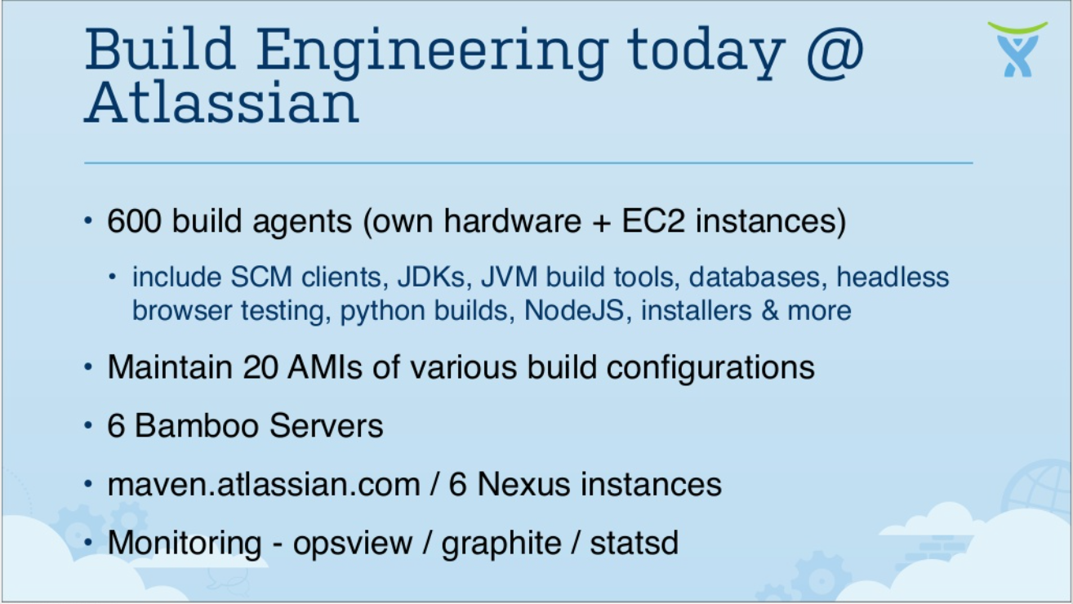
According to Atlassian
Link to Presentation: Puppet Camp Sydney Feb 2014 - A Build Engineering Team’s Journey of Infrastructure as Code
http://www.slideshare.net/PeterLeschev/puppet-camp-sydney-2014-a-build-engineering-teams-journey-of-infrastructure-as-code?qid=fb781be4-a4ed-4b5e-8603-7f0675811b8a&v=qf1&b=&from_search=48

Slide 43

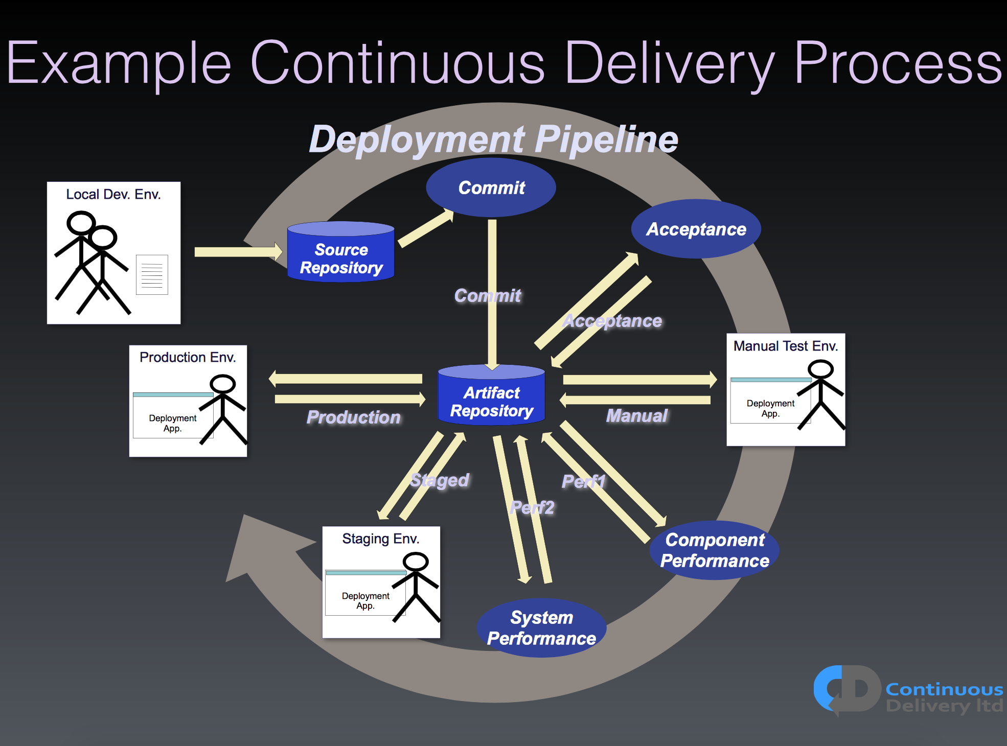
According to Continuous Delivery Ltd
Link to Presentation: The Rationale for Continuous Delivery
http://qconlondon.com/system/files/presentation-slides/The%20Rationale%20of%20Continuous%20Delivery%20-%2045%20Minutes.pdf

Slide 44



bit.ly/SoftwareSupplyChain
2015 State of the Software Supply Chain
Notes:
www.sonatype.org/nexus/
http://bit.ly/1Fc7BRV

Slide 45

bit.ly/1Fc7BRV
Join the Conversation
Notes:
www.sonatype.org/nexus/
http://bit.ly/1Fc7BRV

Slide 46

Check out Volume 2 at: bit.ly/1HUSA6L
Want More?
Notes:
www.sonatype.org/nexus/
http://bit.ly/1Fc7BRV

